Slide 1
Sebastopol Commons
Building the Commons
Public ENGAGEMENT WORKSHOP and OPEN HOUSE
August 13, 2026
WELCOME

Slide 2
INTERVIEW SUMMARY
Groups dealing with the same core problems:
not enough space,
not enough storage,
not enough meeting rooms,
parking issues,
and serious funding pressure
Many organizations are small, mostly volunteer-run, and they’re all struggling with visibility and getting enough people through the door, especially younger folks, families, and Spanish-speaking communities.

Slide 3
Goal is Consistent
A well-designed, centrally located Commons would be a game-changer. People see it as the practical solution to help organizations collaborate, share costs, boost visibility, and actually serve the community better.

Slide 4
Requests
Flexible multi-use spaces (no fixed seating) and plenty of meeting/classrooms At least one good commercial or community kitchen Decent restrooms that are actually in the same building as the events Storage (archives, books, emergency supplies, etc.) Stage/performance area for the arts groups | Outdoor space Good parking and accessibility Some dedicated but shared office/co-working space where groups can keep their own identity and privacy when needed Most want 6–7 day access with long hours. Few thousand square feet up to a total complex around 18–20K sq ft.

Slide 5
Location suggestions
O’Reilly property keeps coming up as really promising because of the parking and existing infrastructure.
01
Downtown/near the Plaza for visibility and walkability.
02
Some folks like the broader corridor idea (Burnett to Ives Park area) or North Town.
03
Strong preference for fixing up existing buildings rather than starting from scratch.
04

Slide 6
SPECIFICS
Community Cultural Center: Needs performance space and sees the Commons as key to keeping concerts and events alive.
Senior Center: Bursting at the seams and needs room to grow.
Health Clinic: Likes the idea of co-locating services and emergency preparedness.
Public radio: Wants to reach more Spanish-speaking and Indigenous families and needs proper event space with kitchen + restrooms.
History Folks: Want display areas and storytelling space.
Library Friends and Civic Groups: Want work/storage space and better coordination.
Almost everyone is open to partnerships and sharing resources.

Slide 7
BIGGER PICTURE
Need:
Better marketing
Restored City support
More public-private partnerships, and
Real outreach to all parts of the community, especially our diverse and lower-income residents.
Decide:
Multiple hubs vs. one giant building.
Now vs. wait.

Slide 8
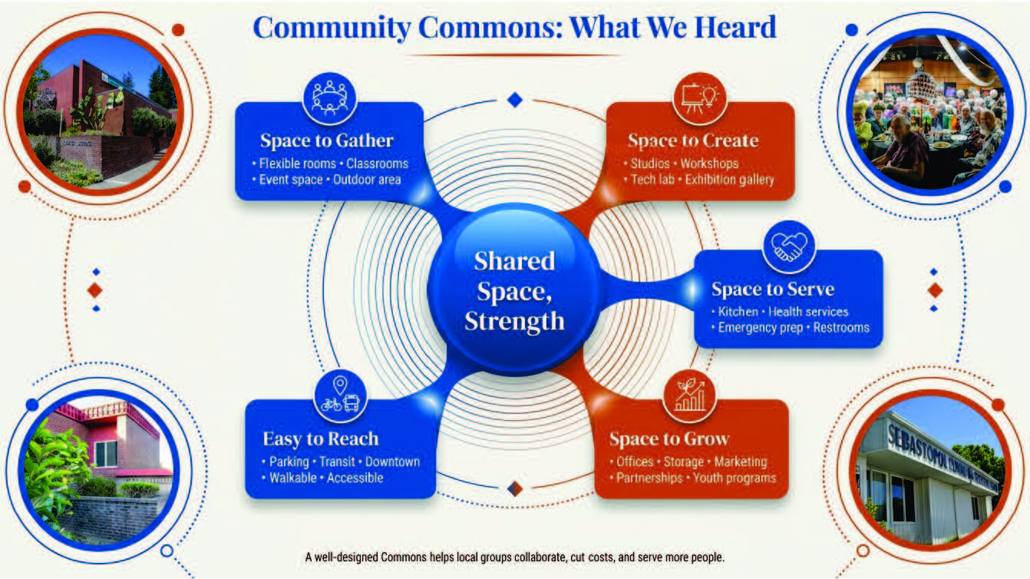

Slide 9
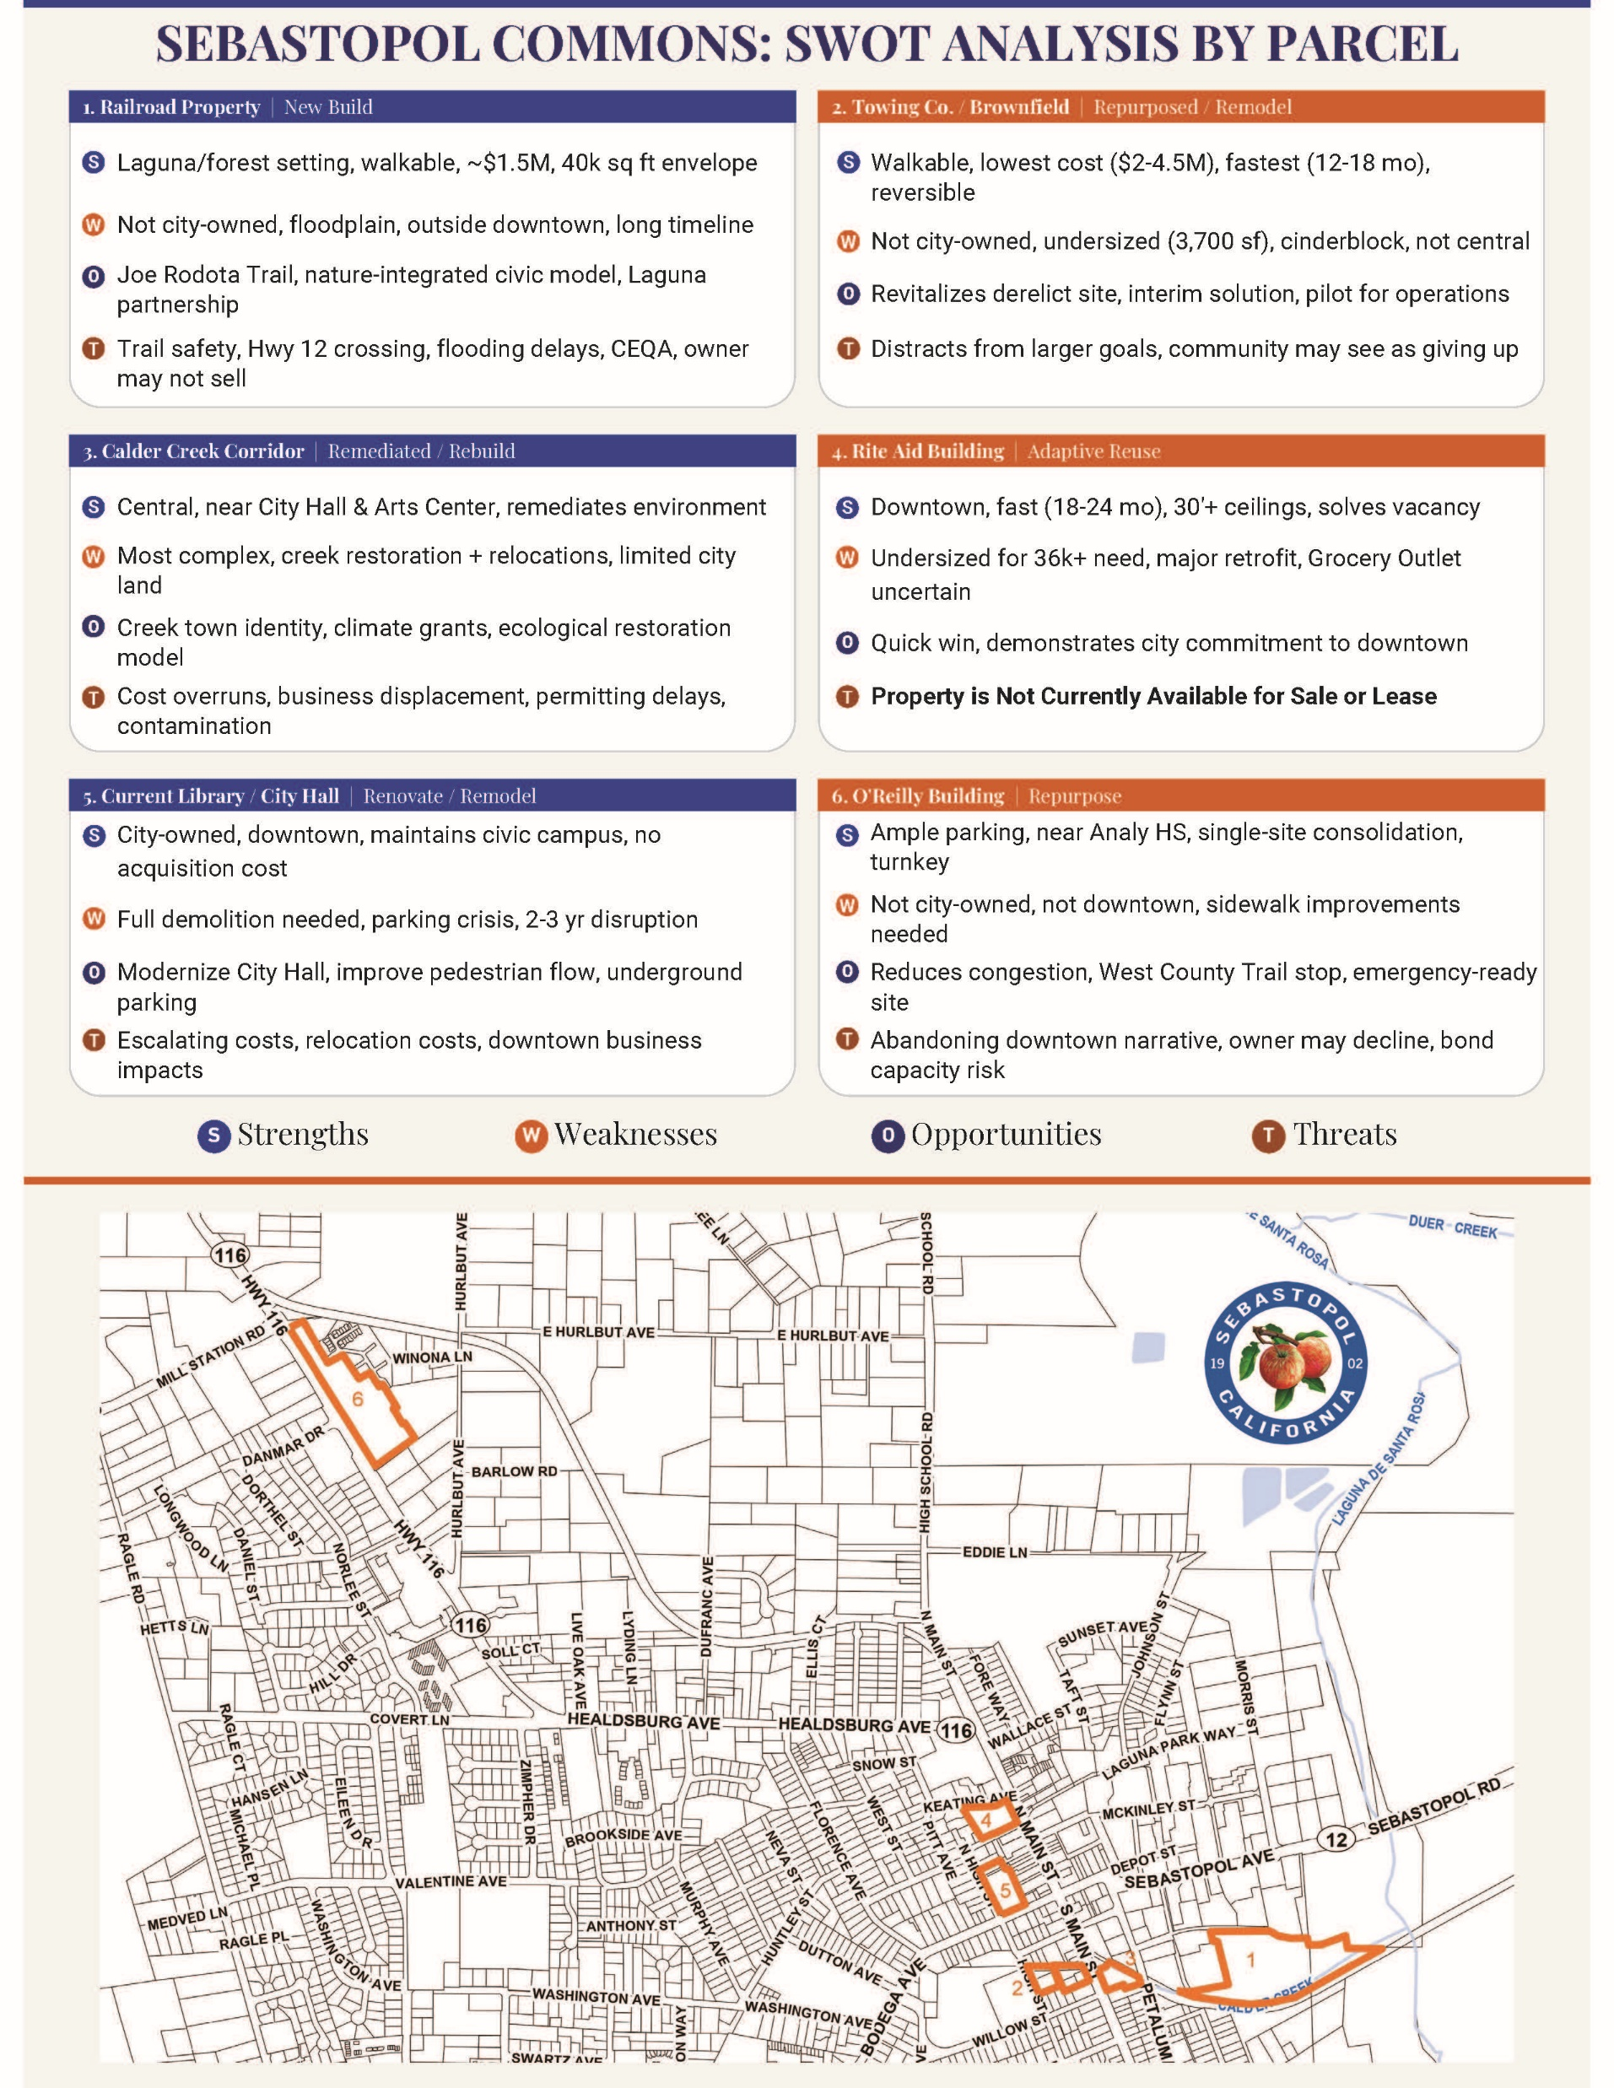

Slide 10
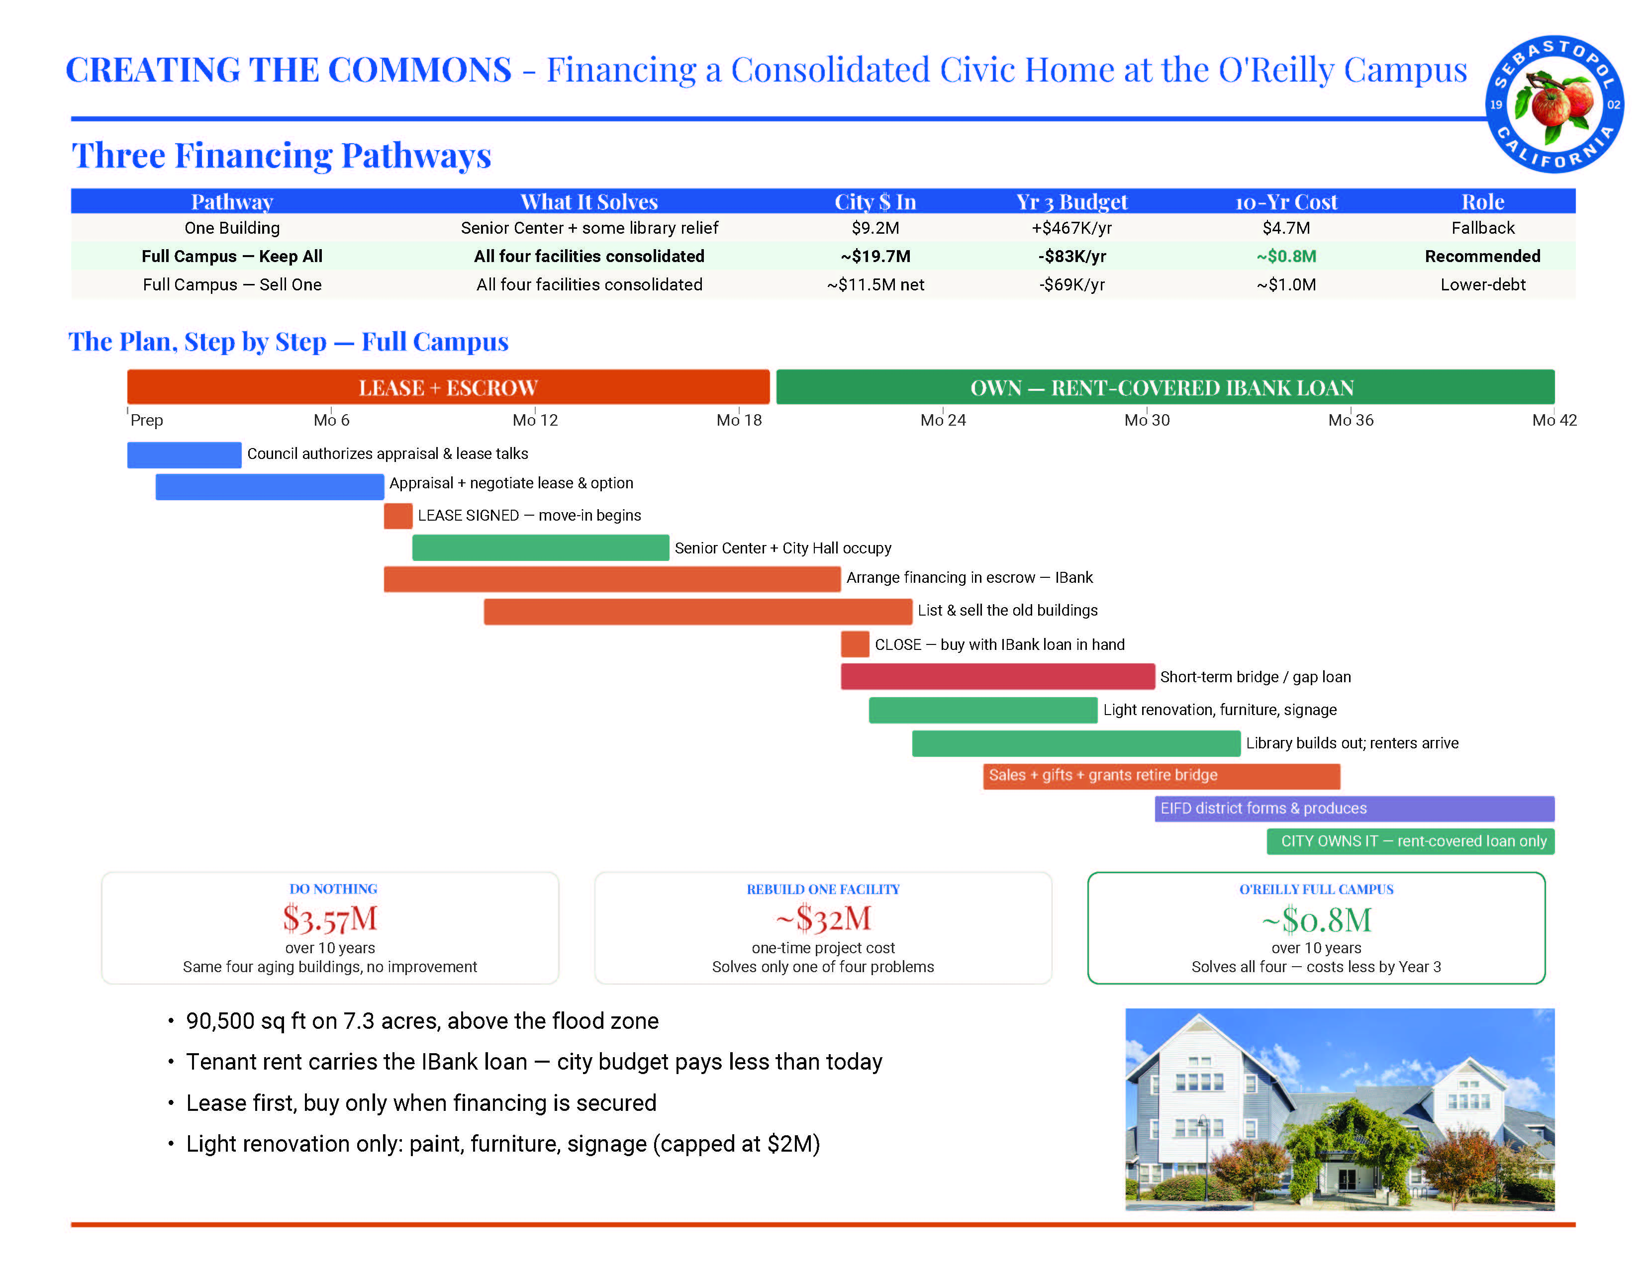

Slide 11
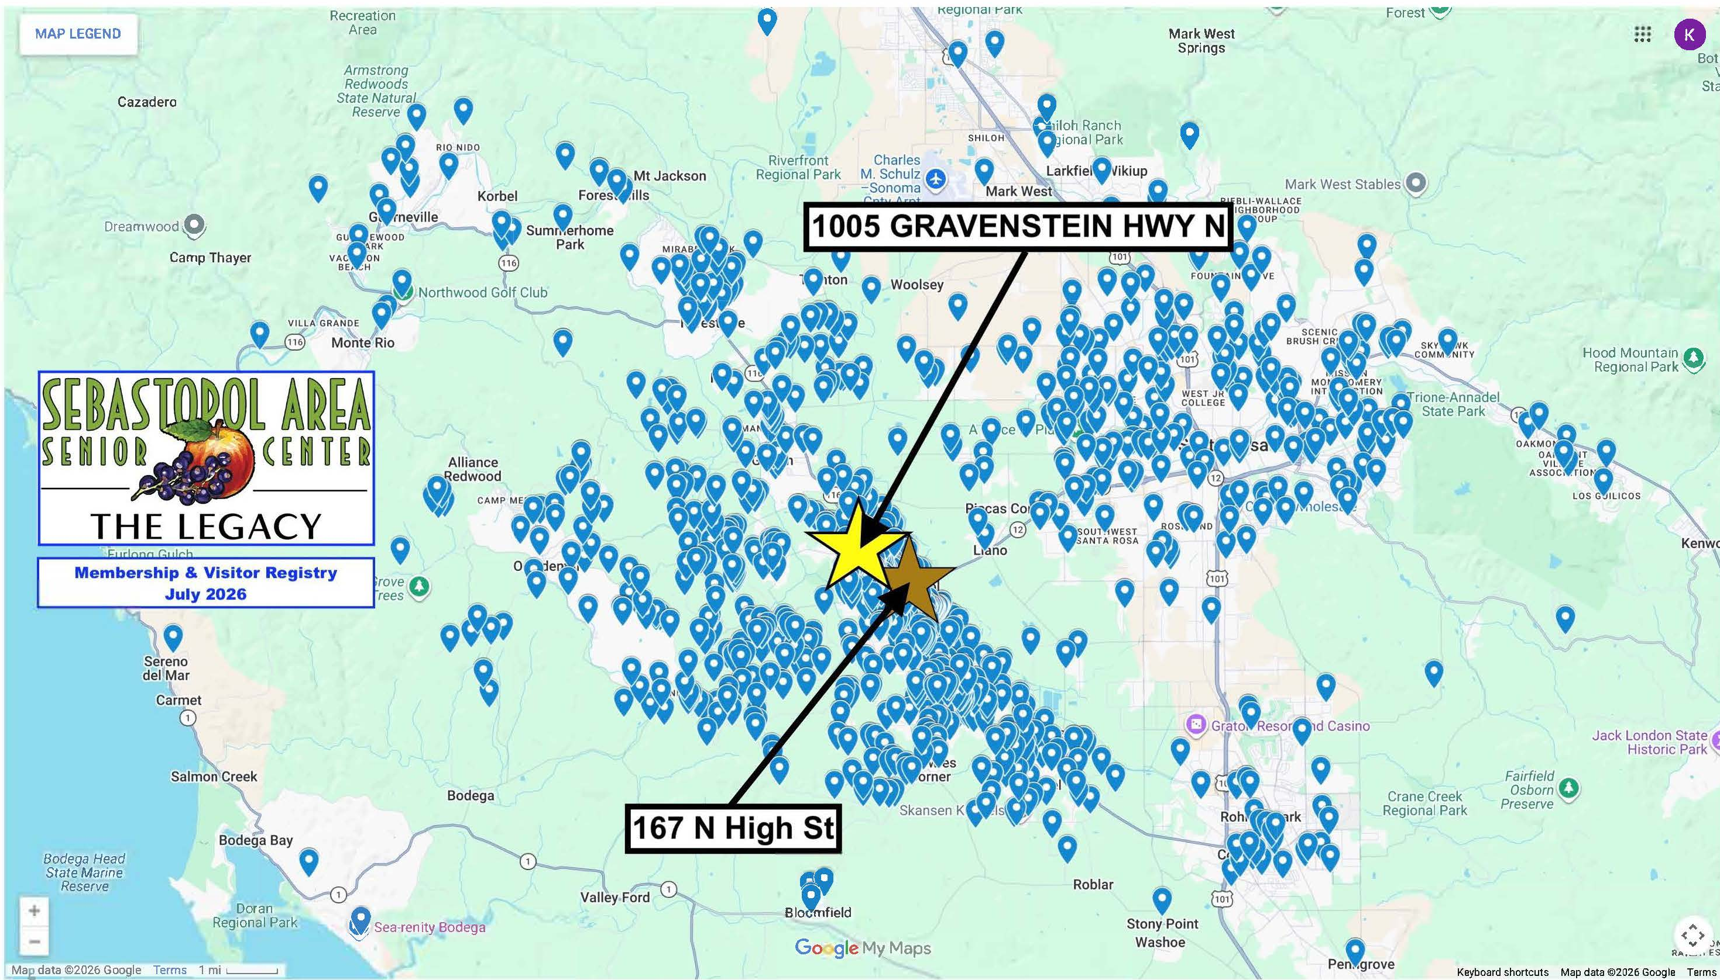

Slide 12
