Slide 1

Sebastopol Library Mold Remediation
City Council
July 7, 2026

Slide 2
Phase I
Proactive Closure
Emergency Response
Containment
Remediation
Assessment
Moisture Testing

Slide 3
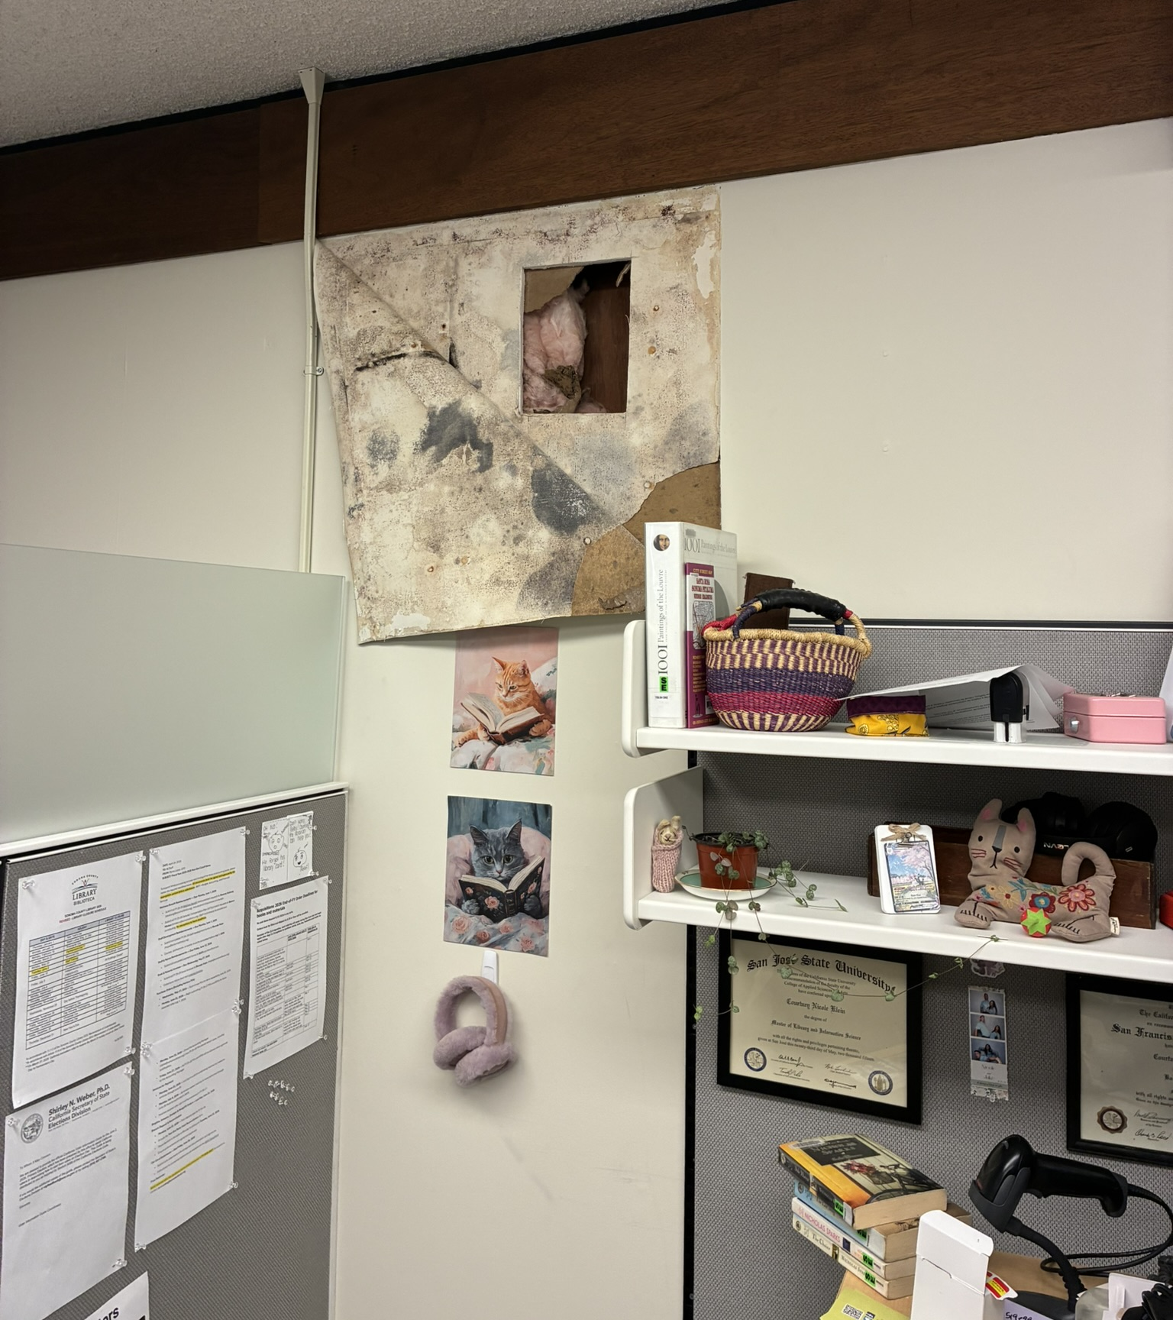
Proactive Closure
Thursday, June 4
Library staff observed peeling wallpaper and moisture intrusion
Library closed immediately to evaluate
Mold discovered during exploratory openings

Slide 4
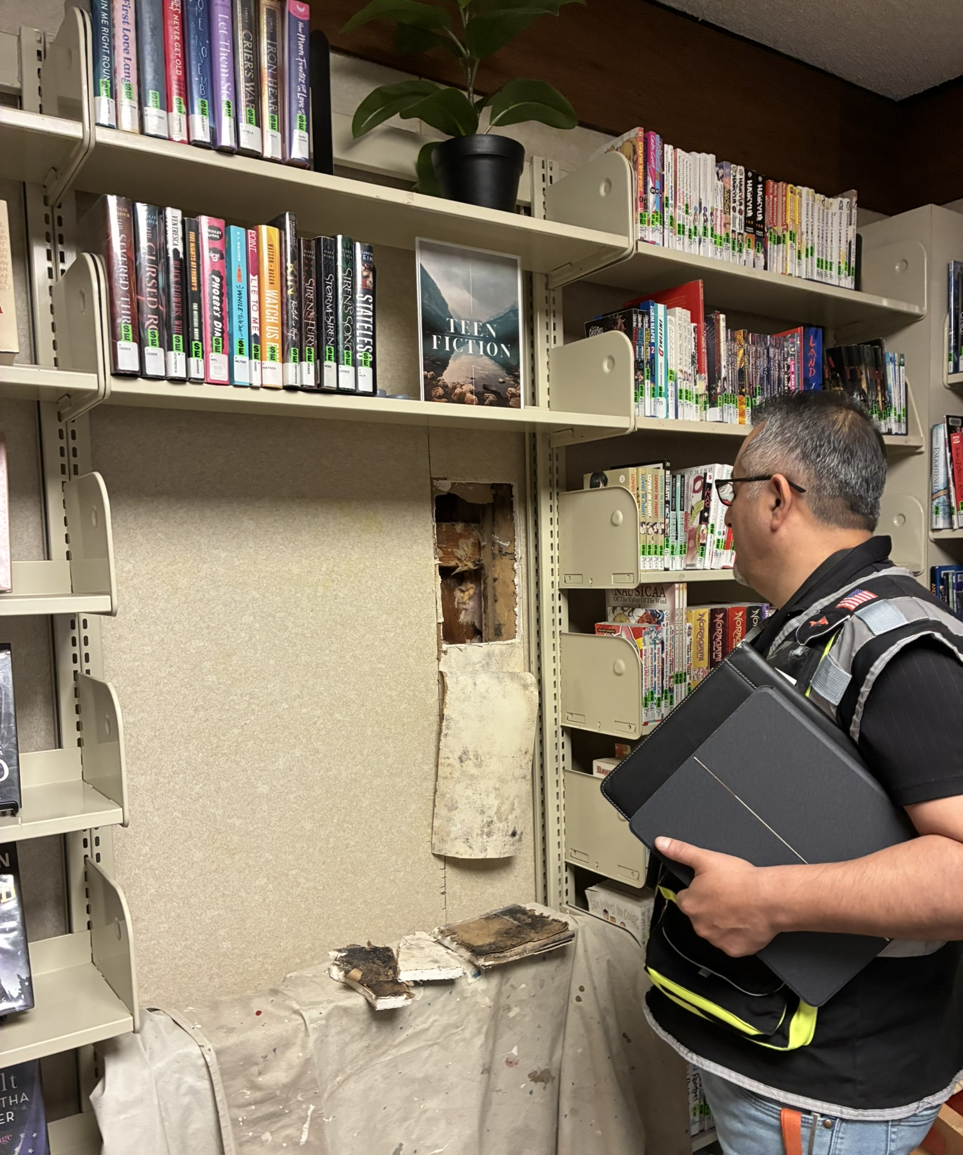
Emergency Response
Friday, June 5
Environmental testing completed
Elevated airborne mold identified in the two rooms with exploratory openings
Stachybotrys (black mold) identified in exposed wall cavities
Begin containment
Note
NO elevated airborne mold identified in the main common areas or other staff rooms of the Library

Slide 5
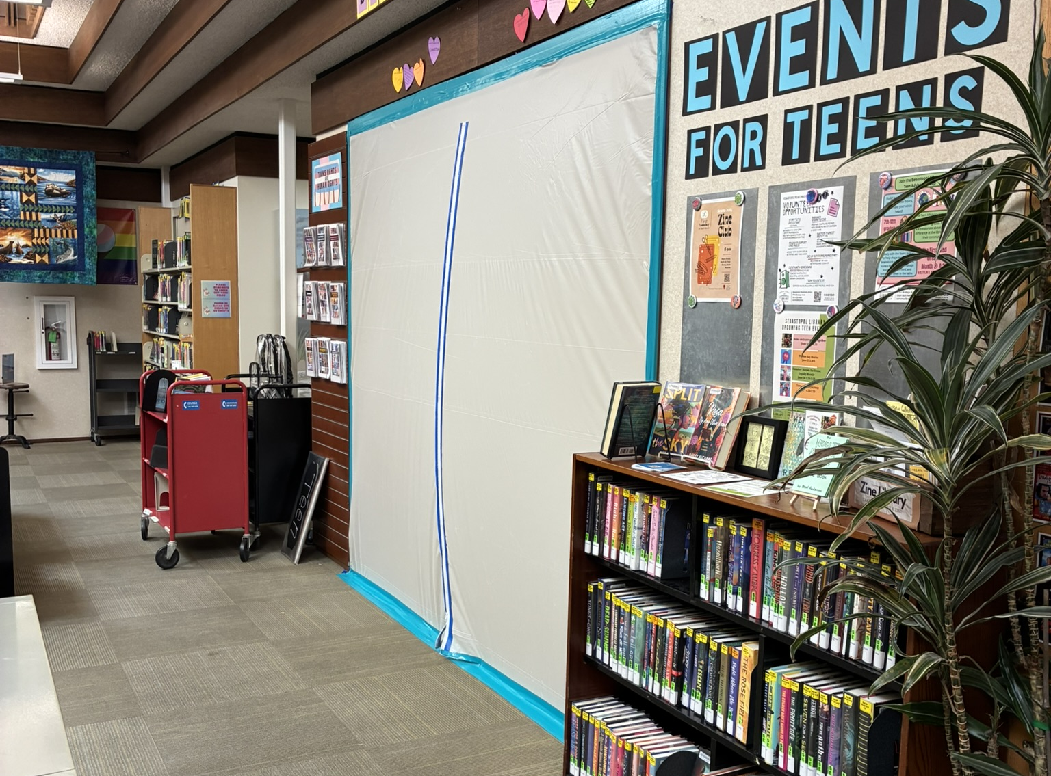
Containment
Containment of Teen Room and Staff Room
HEPA Air Scrubbers throughout Library

Slide 6
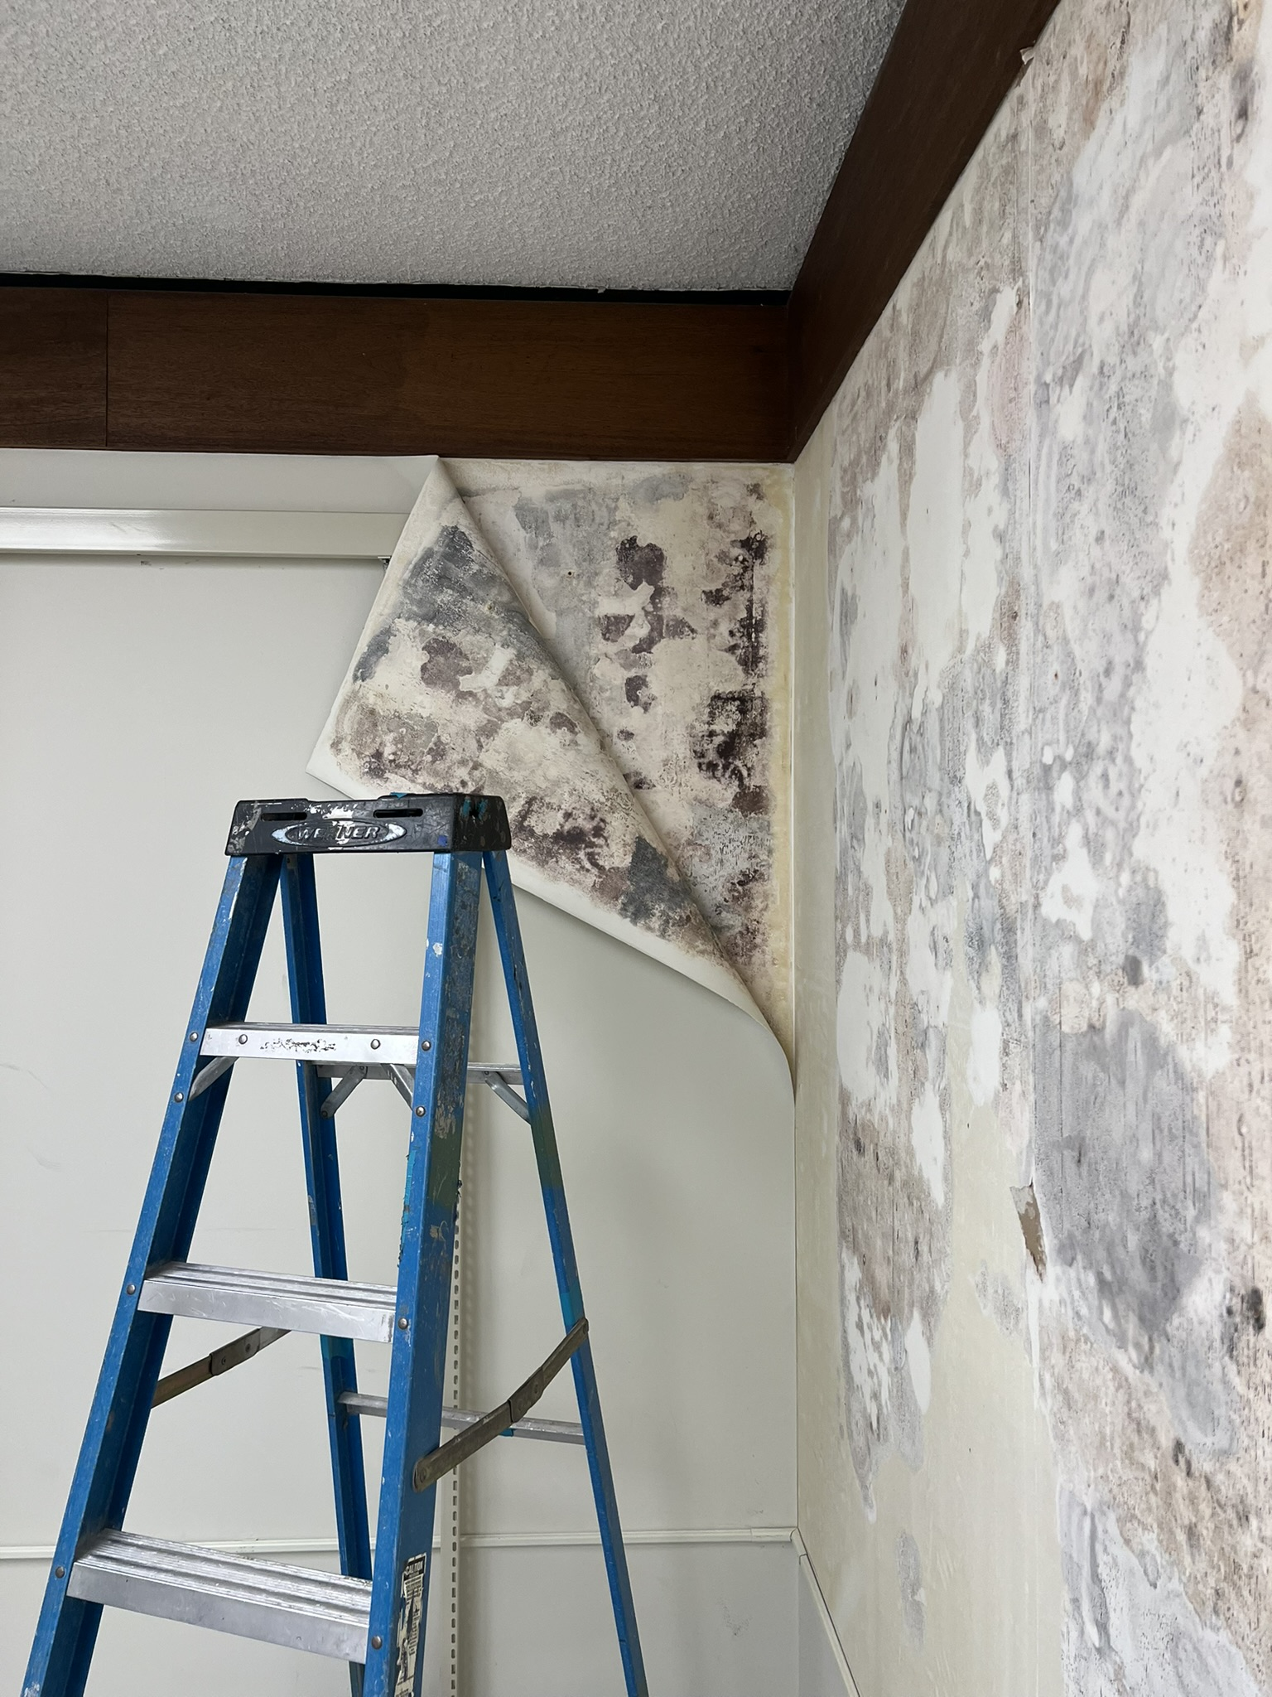
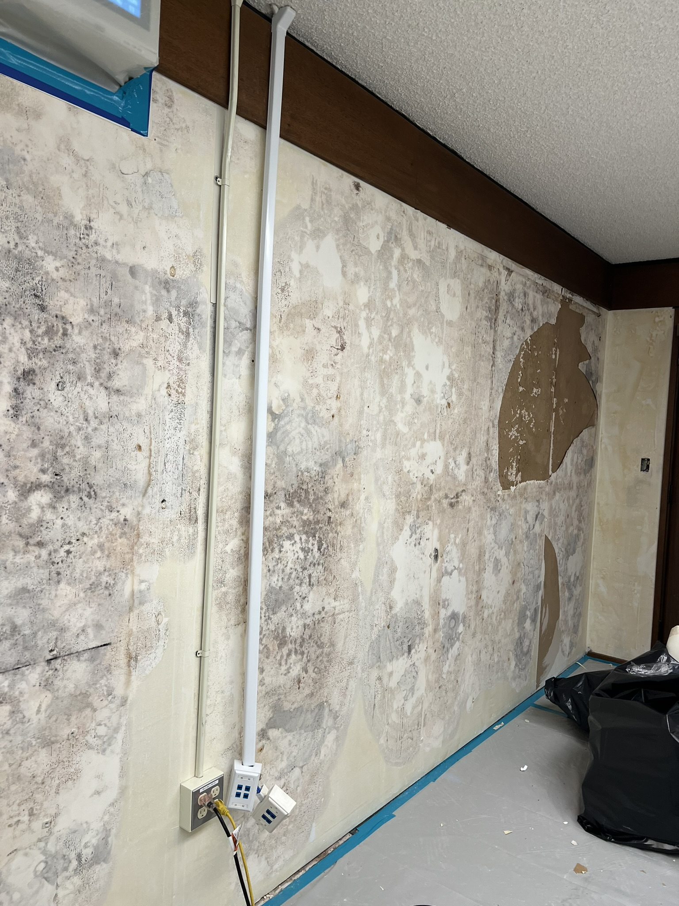

Remediation
June 5–16
Remediation of Teen Reading Room and Staff Room

Slide 7
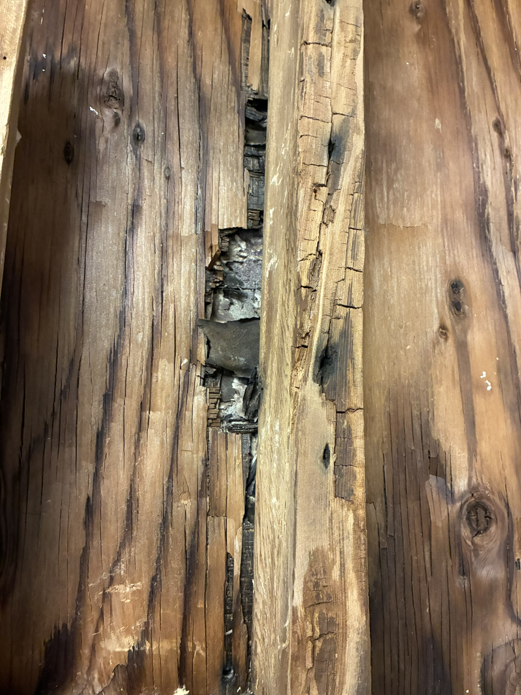
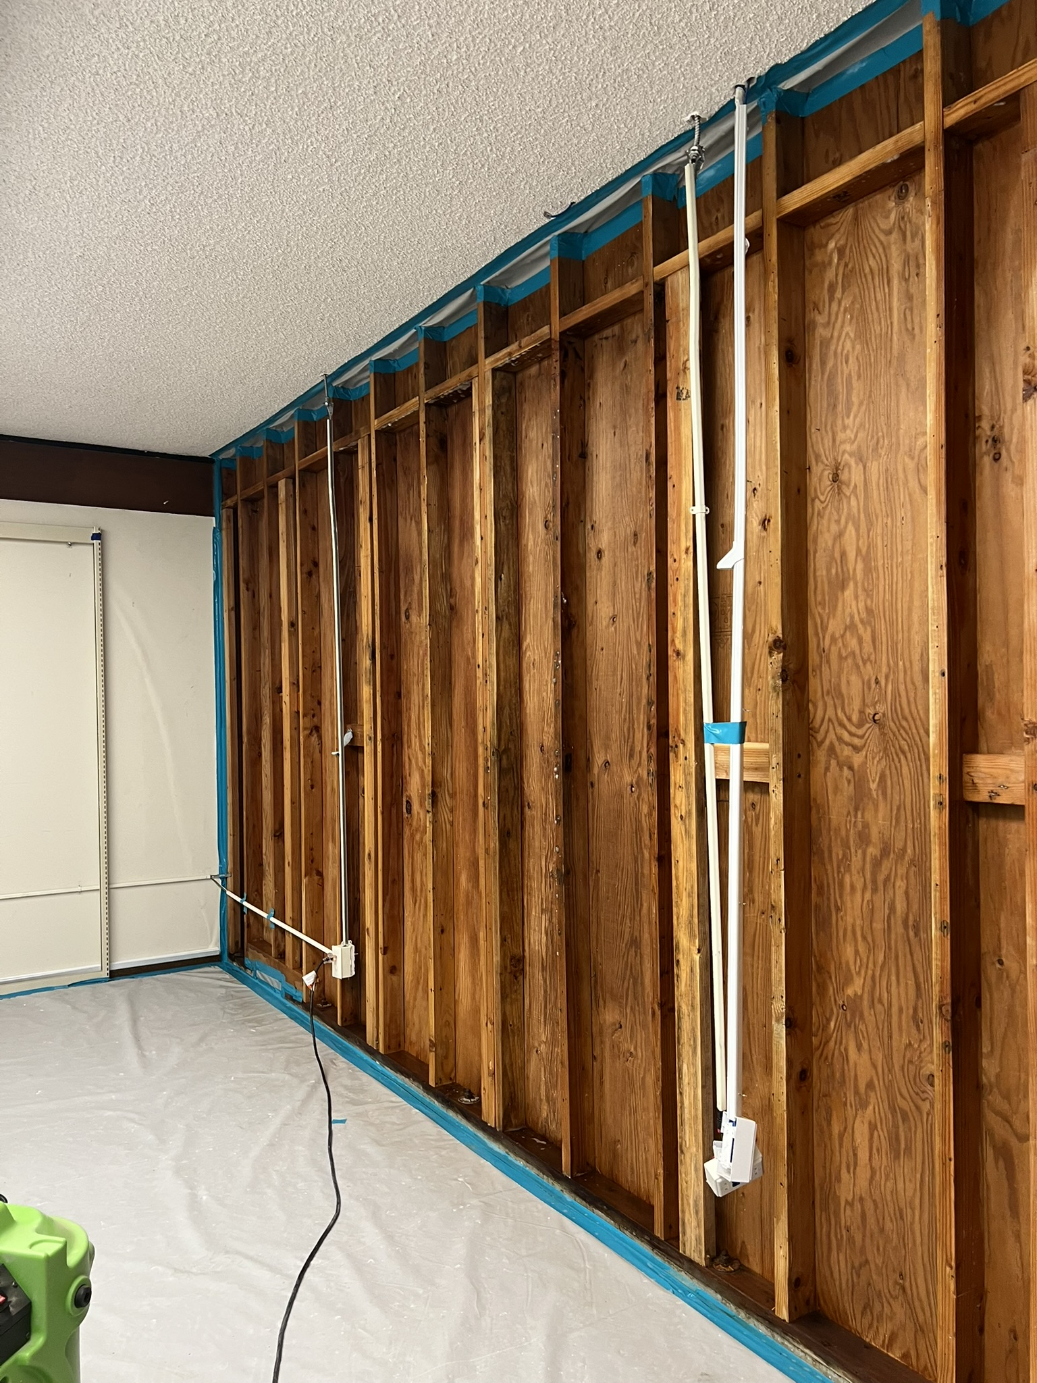
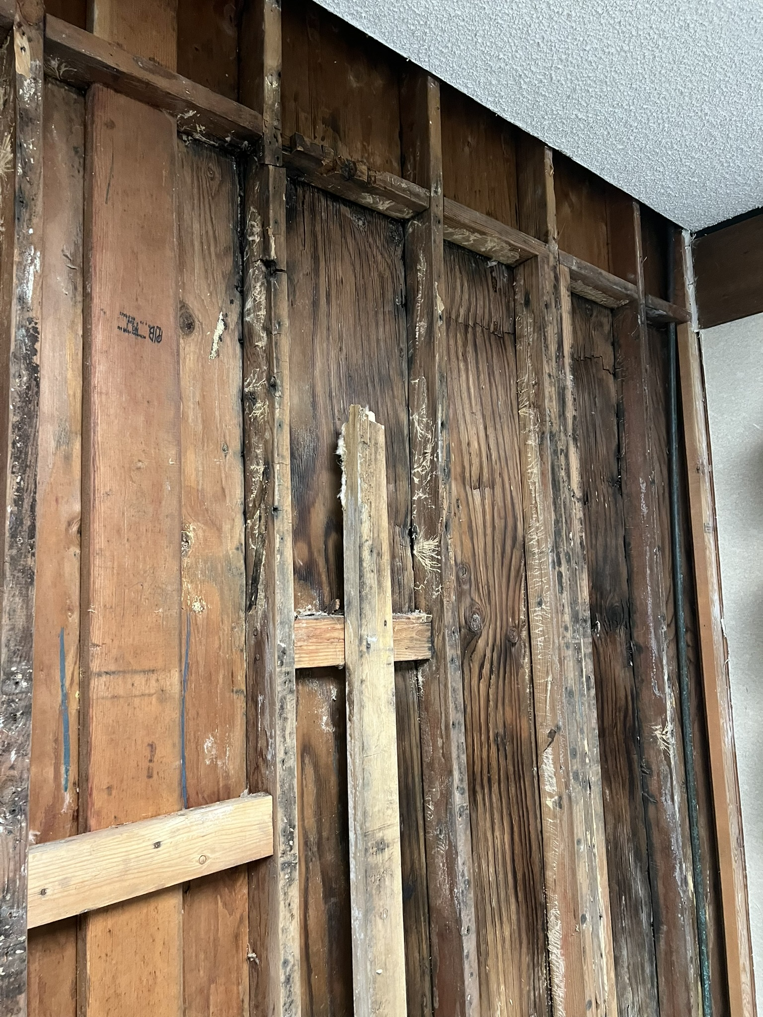
Assessment
Structural Damage Exposed on West Exterior Wall

Slide 8
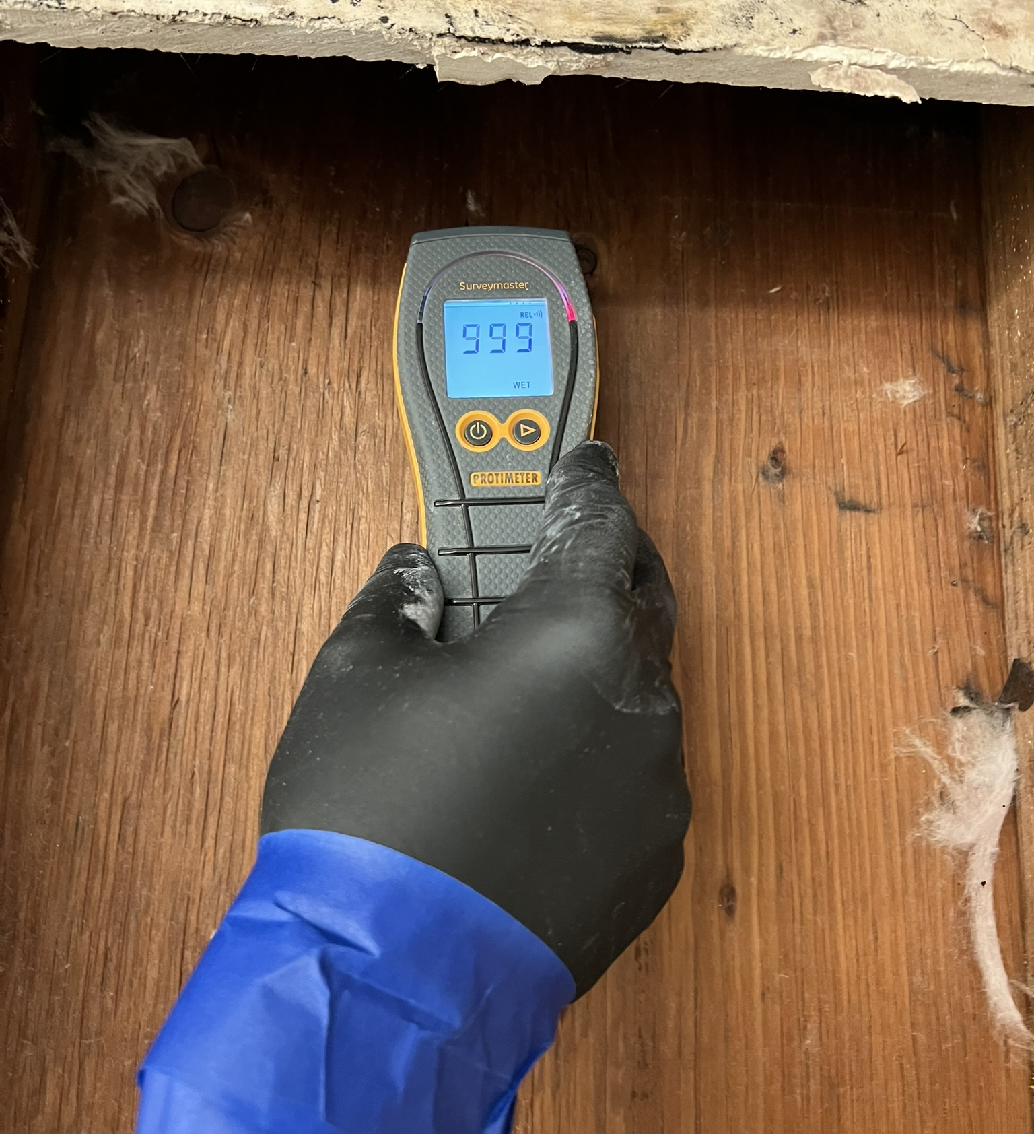
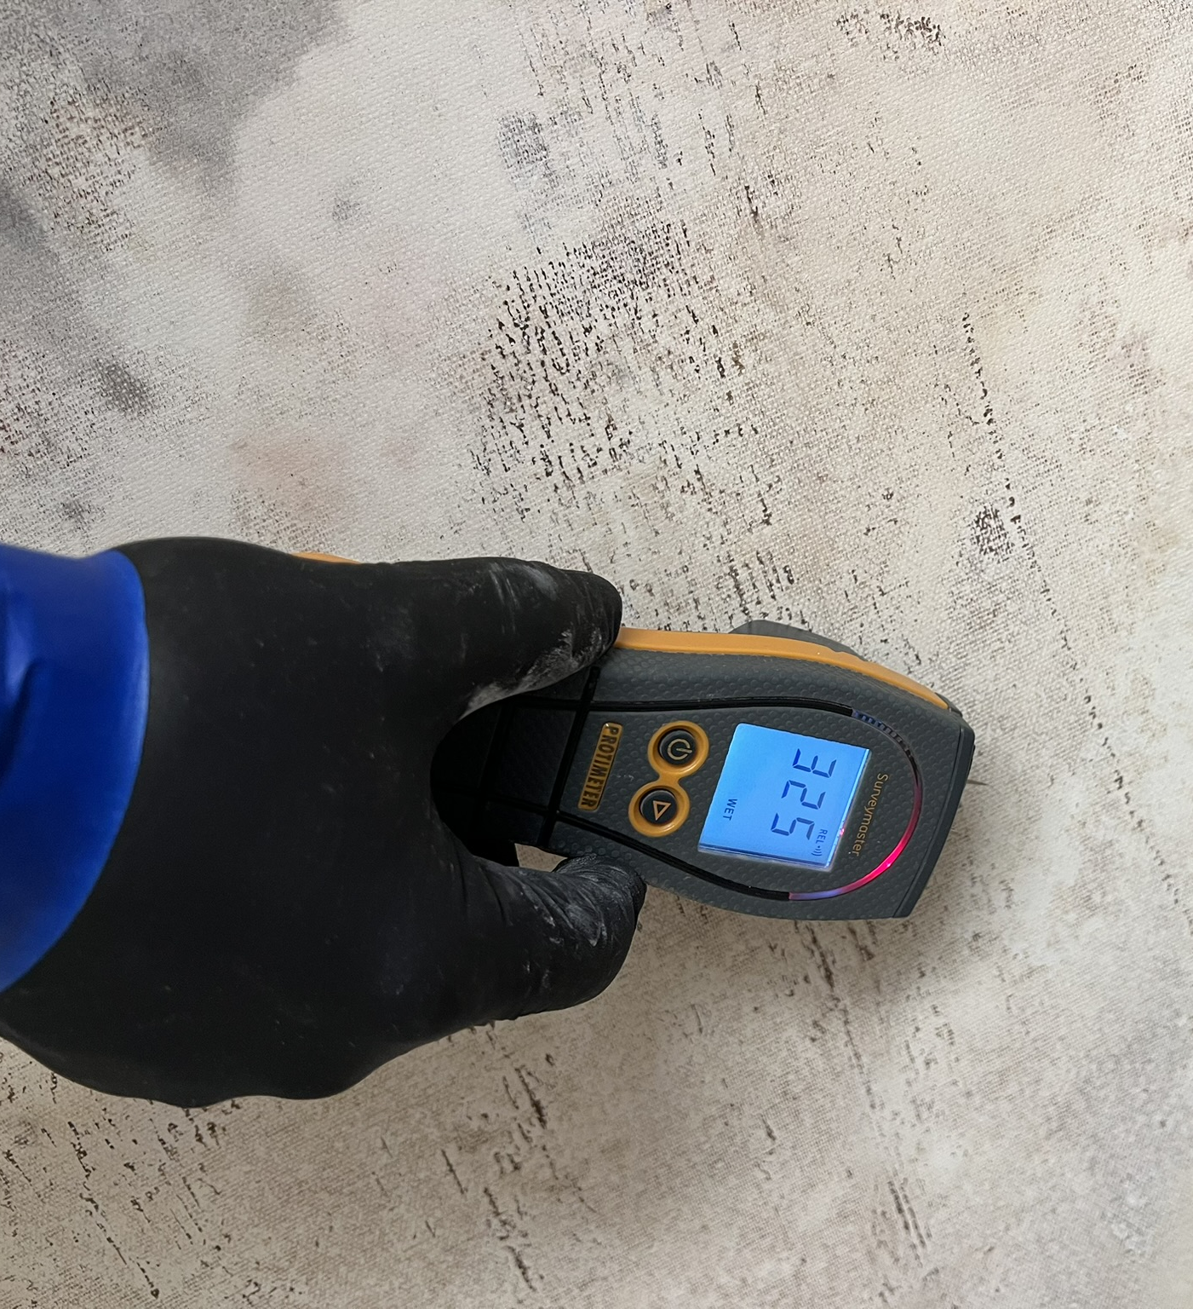
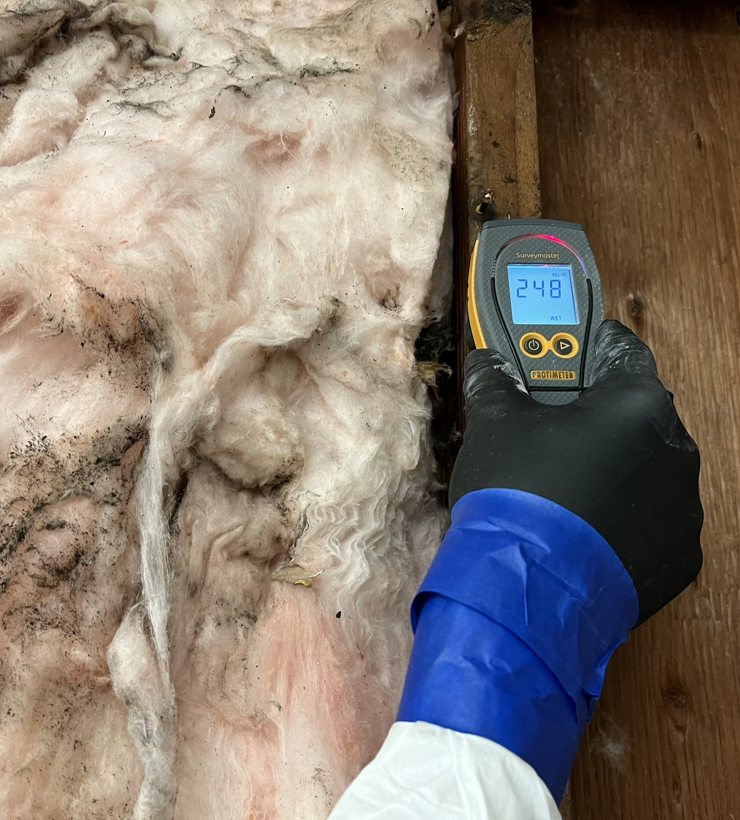
Moisture Testing

Slide 9
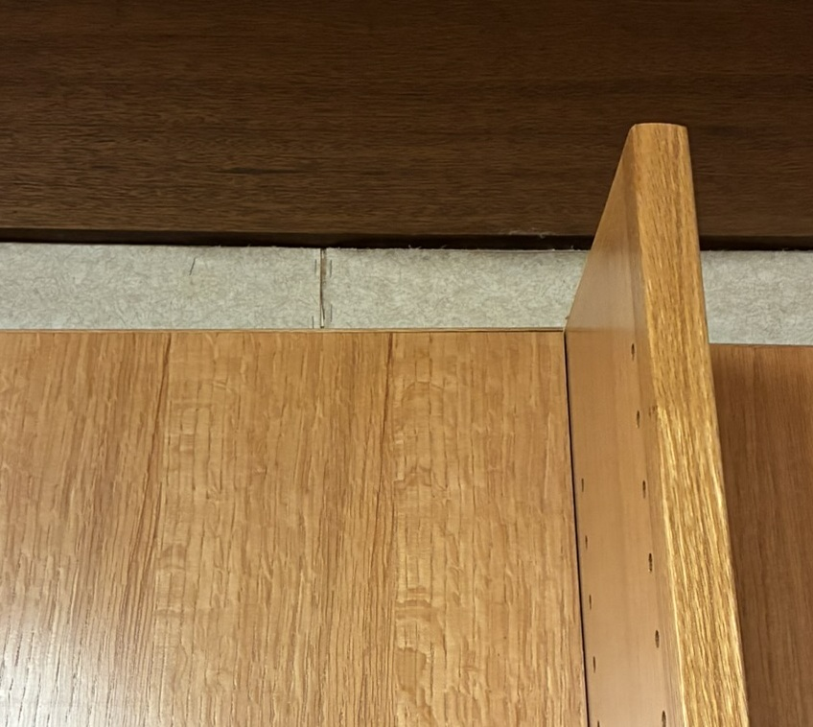
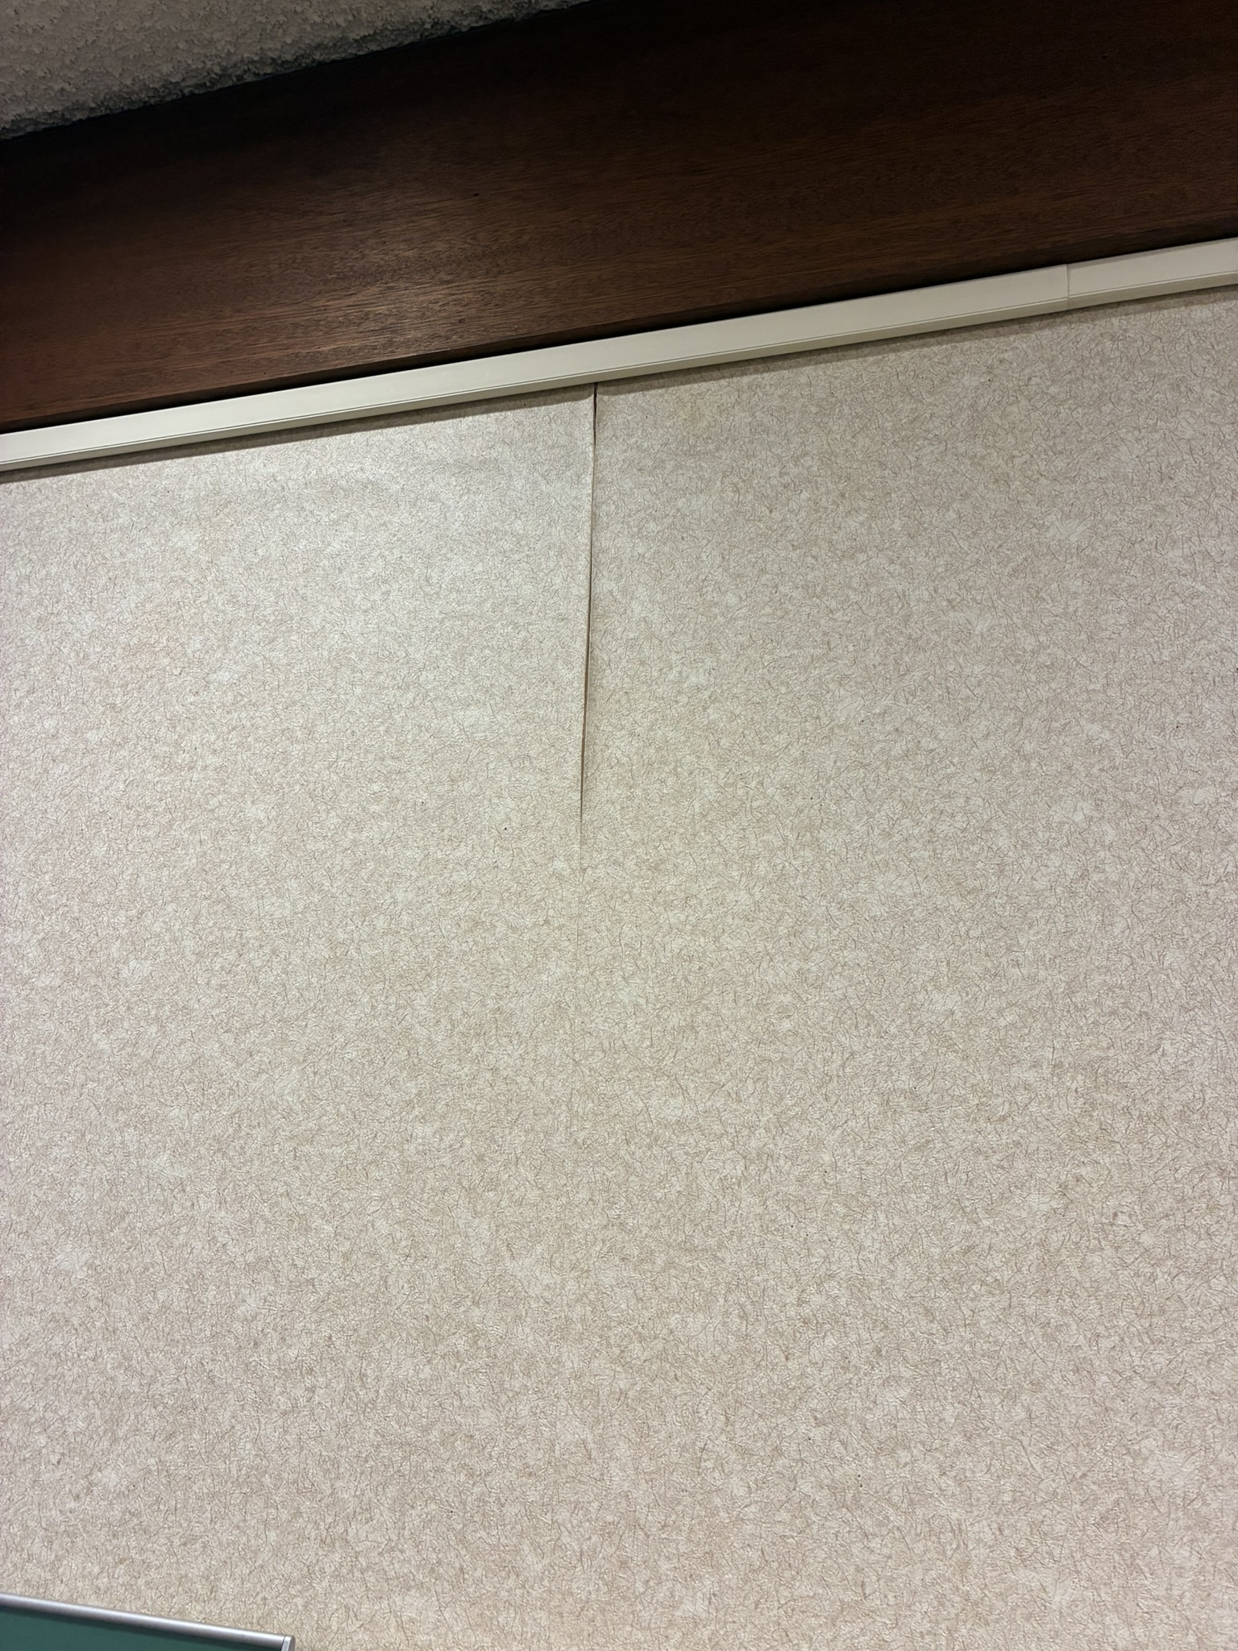
Phase II – Exterior Wall Remediation
Isolate the Exterior Walls
Remove Wallpaper/Sheetrock
Remediate Wall Cavaties
Assess Exterior Structure Damage
Assess Cause of Moisture

Slide 10
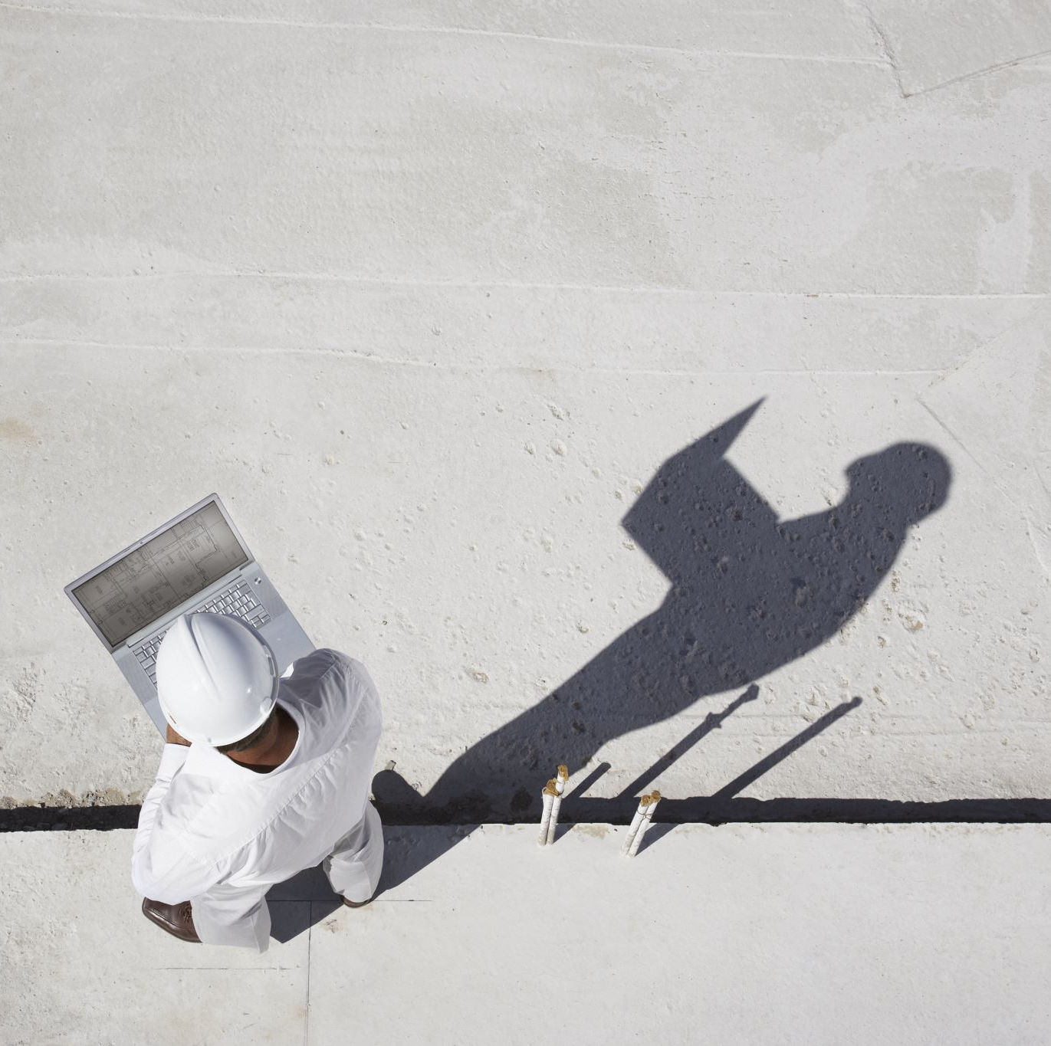
Phase III - Reconstruction
Get bids for Reconstruction
Return for Council Approval of Reconstruction

Slide 11
Sebastopol Library Remediation - Current Budget
 | Costs | Fund Balance
Phase I – Initial Emergency Response (Sebastopol Share - 50%) | $23,844
Phase II – Remediation of Exterior Walls | $175,000
Phase III – VERY Preliminary Estimates | $200,000
Total | $398,844
Building Reserve Fund |  | $594,939
Difference: $196,095

Slide 12
Request of City Council Today
Approve $47,688 for emergency mold testing, containment, cleanup, and investigation work already completed at the Library.
Authorize up to $175,000 for the next phase of work to open exterior walls, investigate the extent of the damage, and remediate mold and moisture intrusion.

Slide 13
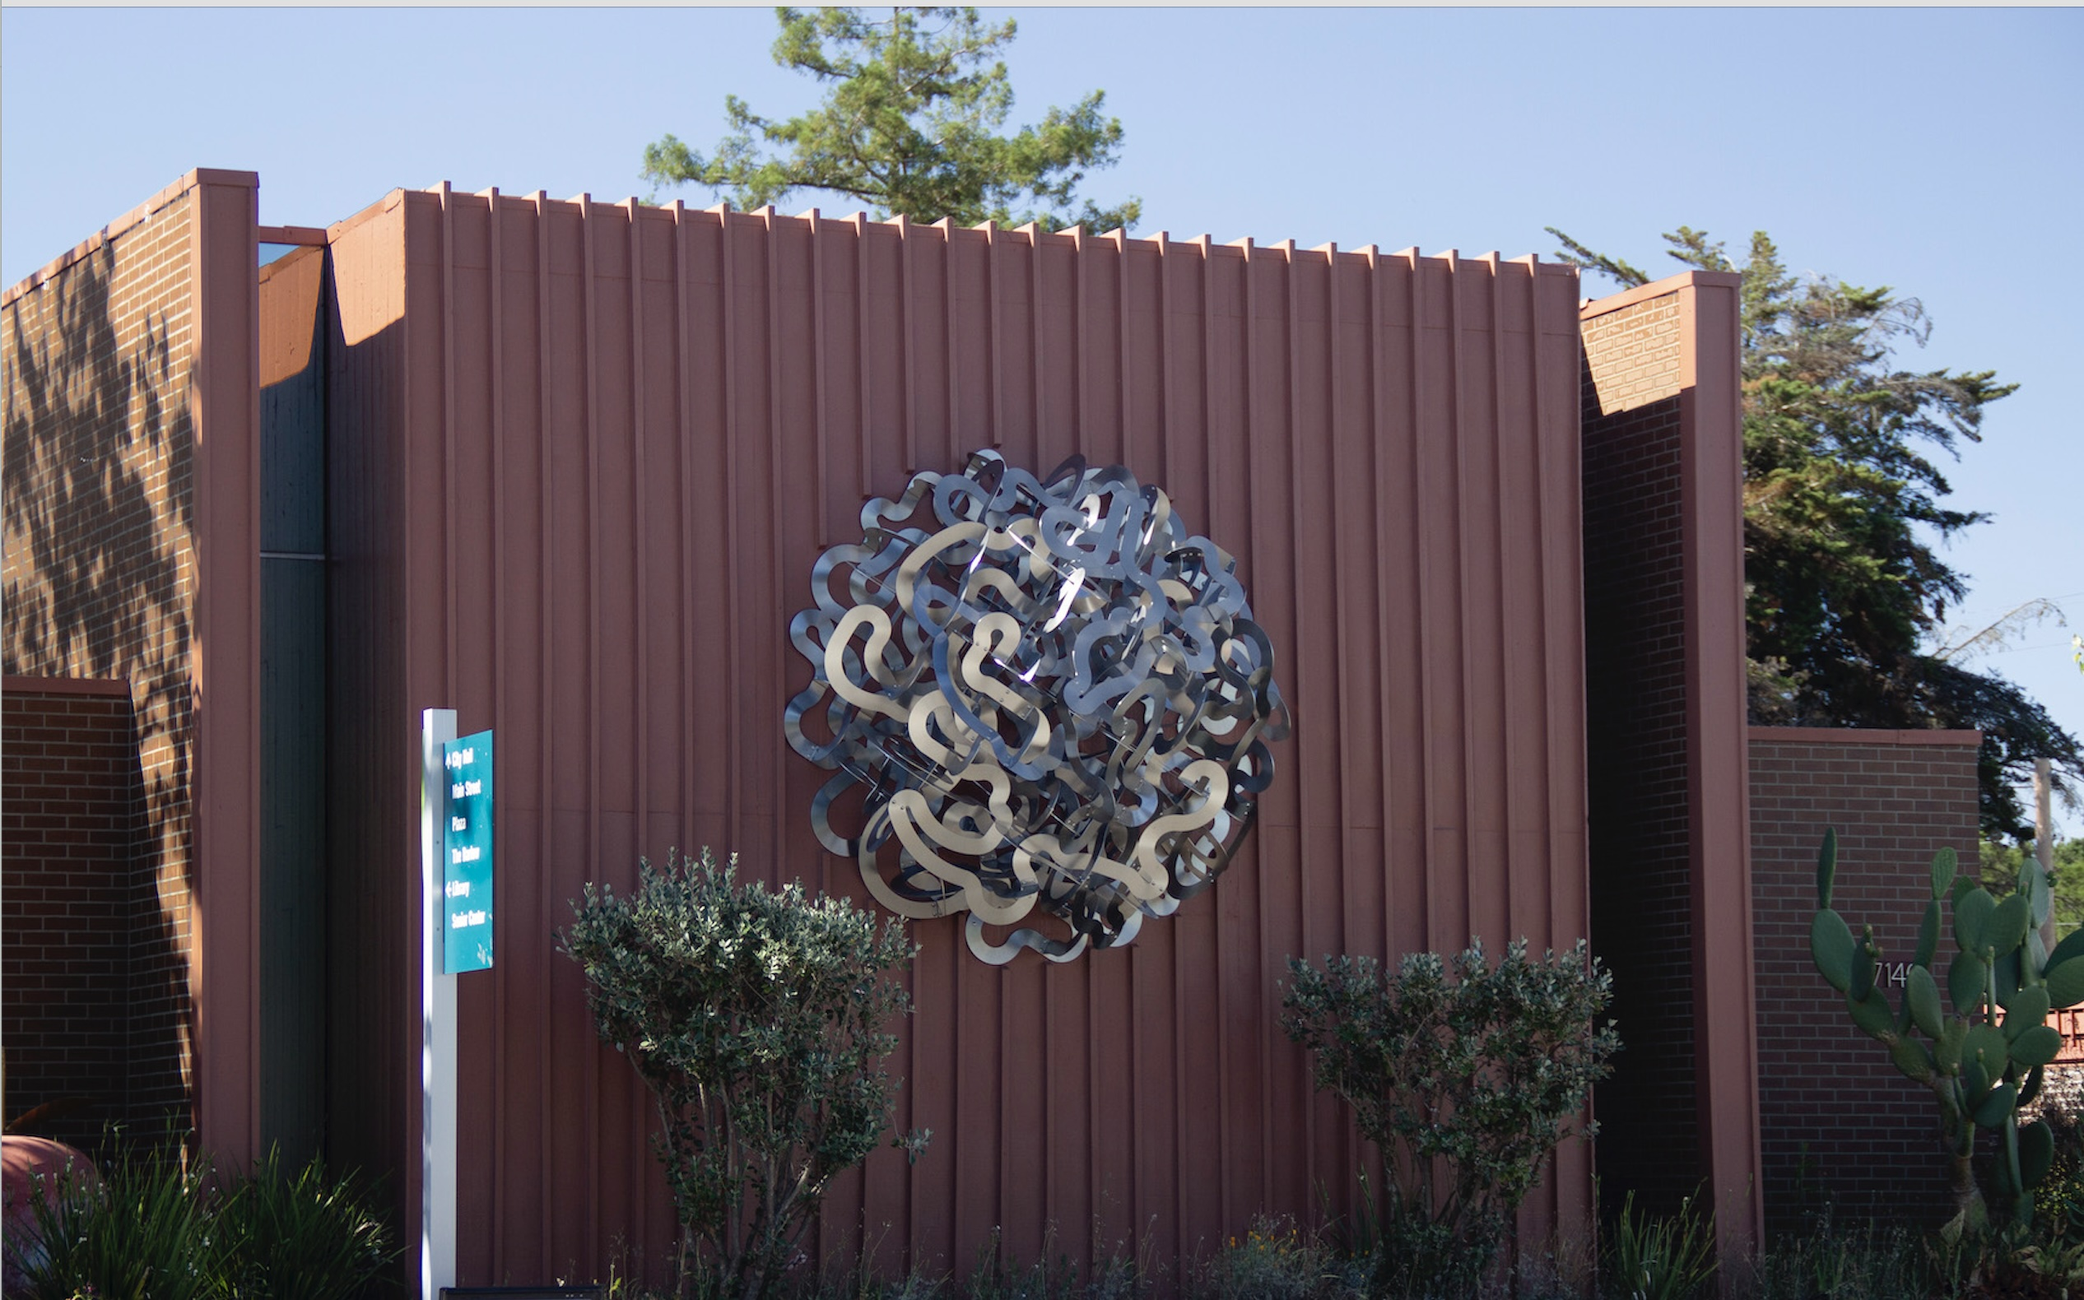
Questions?

