Slide 1
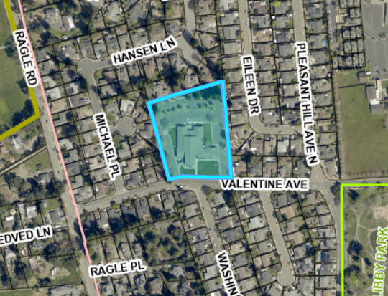
8100 Valentine
20-lot Subdivision with 20 SFDs
Up to 19 detached ADU’s.
Three of the Single-Family Homes will be deed restricted affordable at 120% AMI.

Slide 2
Project Details
General Plan Land Use Medium Density Residential
Zoning Single Family Residential (R4)
Required Proposed
Density (ADUs do not count) 5 to 8.7 7.4
Parking stalls 40 83
Setbacks
Front 20 15
Side 5-9ft 4ft
Rear 20-30ft 10ft

Slide 3
Project Entitlements
Vesting Tentative Map for the subdivision of land
Density Bonus for reduction waivers of the following development standards;
  Minimum lot area Minimum lot width
  Building height Minimum yard setbacks
  Maximum lot coverage Special setbacks-mechanical equipment
  Parking spaces located on the same parcel Maximum Parking stall depth
The project was reviewed for consistency with the Sebastopol General Plan to enable use of California Environmental Quality Act (CEQA) exemption Section 15183, Consistency with a General or Community Plan. Project deemed consistent as conditioned.

Slide 4
Legal framework
The intent of SB 330 is to expand housing supply by removing local barriers, stopping project delays, and freezing development standards at time of application.
SB 330 and Housing Accountability Act (HAA)
  Limits on number of hearings
  Grants vested rights via a preliminary application
  Works alongside Density Bonus Law to provide waivers and concessions

Slide 5
  The intent of Density Bonus Law is to offset the cost of building housing and eliminate local barriers that would otherwise make projects physically or economically infeasible to build.
Government Code 65915 (Density Bonus Law)
  If a developer agrees to include at least 10% of its total units as affordable, the developer is eligible and can request waivers and concessions from zoning requirements like development standards which include parking, setbacks, and building height.
  This project qualifies for one (1) concession and an unlimited number of waivers.
  The City must grant these concessions and waivers unless there is evidence in the record of a specific, quantifiable impact to public health and safety, and there is no feasible alternative to mitigate that impact.

Slide 6
How SB 330 and HAA work together
Under SB 330/HAA, the City may not deny a project, or approve it with a decreased density, if the project complies with all applicable objective standards (with very limited exceptions)
A project that does not comply with an adopted objective standard because it has been granted a waiver or concession under the Density Bonus Law, is deemed to comply with the standards for the purposes of SB 330/HAA

Slide 7
CEQA Section 15183
A Section 15183 exemption applies to projects that are consistent with the density and development standards already analyzed in a certified EIR for the General Plan. It requires agencies to avoid duplicative environmental review when a project doesn't raise impacts peculiar to the site or impacts not already addressed in the prior EIR.
The CEQA check list studied the following categories:
Aesthetics
Air Quality
Biological Resources
Cultural Resources
Geology and Soils
Greenhouse Gas Emissions
Hazards and Hazardous Materials
Land Use and Planning
Noise
Population and Housing
Public Services
Transportation
Tribal Cultural Resources
Utilities and Service Systems

Slide 8
Staff Recommendation
Staff recommends the Planning Commission take the following actions: (1) determine, based on the Section 15183 Consistency Checklist, that the project is exempt from additional environmental review pursuant to CEQA Guidelines Section 15183; and (2) adopt the attached draft Resolution recommending that the City Council approve the Vesting Tentative Map and State Density Bonus Application for the 8100 Valentine Avenue project, including the associated Findings, subject to the recommended Conditions of Approval.
Or
Recommend that the City Council deny the Vesting Tentative Map and State Density Bonus Application for the 8100 Valentine Avenue project and adopt a modified resolution to reflect this recommendation

