Slide 1

Future Pathways
Sebastopol Climate Action Committee
Report from October meeting and survey
November 2023

Slide 2
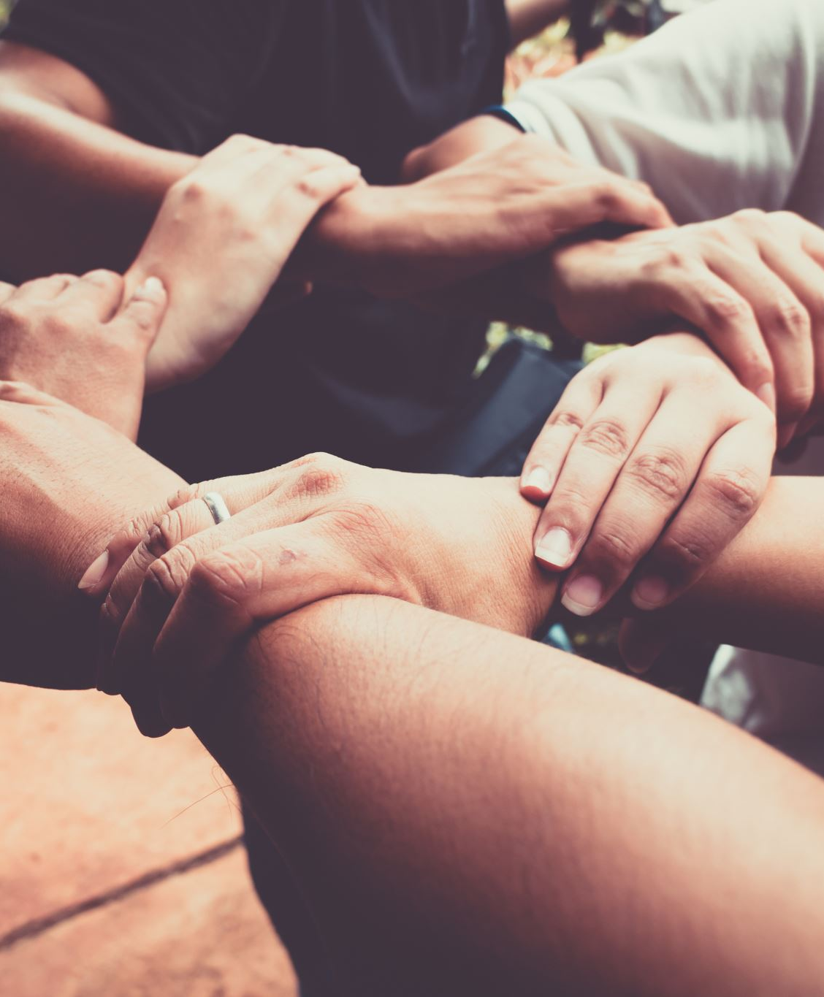
What’s working well?
Respect and engagement
Public input
Meeting efficiency
Compost days
Research & follow-through
Staff support
Determination & diversity
Process learning, getting stuff done, positive tensions, public events

Slide 3
What could we change?
Purpose & methods
More collaboration/leverage with other groups
Focus v dispersal, tangible goals, proactivity
Increase connectivity w city staff/involvement with city decisions
Fundraising/funding
Increase adaptation strategies
Meeting format/content
More working group engagement/discussion with full group
Tone v effectiveness
Chairing direction/more efficiency
Visioning/global view
More personal connections

Slide 4
What could we change?
Sustaining energy of members
Public engagement/volunteers
Consider reverting to citizen group
Staff time used/cost to city
Diversity/outreach
Meetings times & format

Slide 5
Staying a city committee
Pros:
Amplification
Policy access (?)
Credibility
Staff access
Process learning
Official status
Cons:
Meeting requirements/process
Brown Act
Slow timelines
Limited staff time
Limited integration
Lack of funding

Slide 6
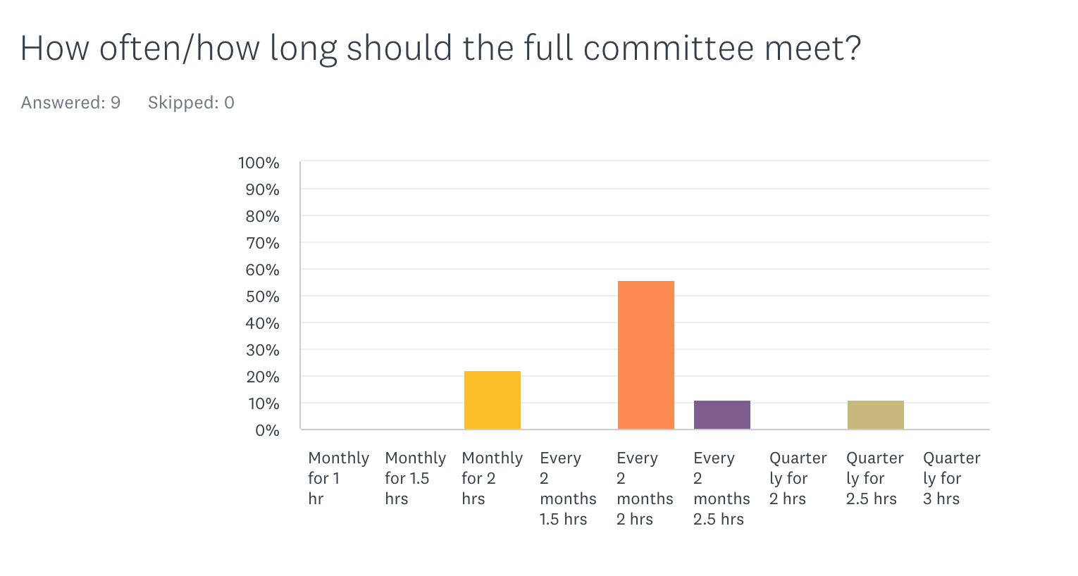
Survey results

Slide 7
Whom should we work with?
Rahus/Carbon Conversations
Bike Sebastopol/Bike Coalition
Building decarbonization coalition
Public library
Schools
Grange
Local service clubs
Time bank
Cool Petaluma, North Bay Organizing Project, Daily Acts, LandPaths, Sebastopol-based CBOs, Laguna Foundation, Community Seed Exchange, Chimera Arts, Repair café, Conservation Works, gardeners, Safe Routes to school
“CAC needs to be re-imagined in order to do this.“

Slide 8
Volunteer engagement
Coordination
  A coordinator
  Enlist a Volunteer Coordinator
  Pull in people to work on specific projects. Assign mentor to Youth Reps, and give them community engagement credit
  Communicate our projects better, have clear asks about a volunteer job or a need for help, have a volunteer coordinator who welcomes interested parties, plugs them in and checks back with them
  Partner with local orgs to work projects not more meetings. Then strengthen connection to local schools who would work on projects if there was a volunteer coordinator linked to various orgs
Inspiration
  If we are doing interesting and exciting projects volunteers will join us
  A good way to engage our members might be to have the working groups each develop a work plan for the year to set out some goals and expectations that might help organize and motivate
Awareness
  Have a table at the Farmer's Market and other community events
  Establish email database
Capacity
  It requires us being engaged much more to be able to get more engagement. Not sure if there is the bandwidth
  CAC doesn't currently have this capacity - perhaps it should really be a non-city person, so there is less red tape

Slide 9
Other comments
If there was a CAC meeting every other month, or less often, working groups would have an opening for meeting together and working on their projects Rethink what is expected of CAC members. WHAT happened to the Grant Writer that Seb Climate Action group (precursor to CAC) recommended? Reimagine how CAC and others interface with the city regarding Climate related projects. Thanks for all the great work! I'll try to show up more in '24!!

Slide 10
Emerging themes: what we want
Increased effectiveness at influencing policies and actions of city
Better connectivity (other groups, volunteers, public, each other)
More clear sense of progress toward meaningful goals

Slide 11
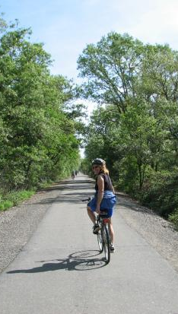
Bike trail map forward
Reinstatement of steering committee: chairs and CC members, possibly staff
Redesign meeting cadence
Prioritization of WG reports/discussions in agenda
Work plan revision for 2024
Leverage existing citizen groups for outreach/education
Streamline goals/plan
Reassess committee status in one year

