Slide 1
SB 743
?
Updating the City of Sebastopol on the Switch to VMT
www.fehrandpeers
July 25, 2023

Slide 2
Change
NEW LAWS
SB 743
AB 417
AB 2245
www.fehrandpeers
SB 226
Continued Legislative Influence
AB 1358
innovation
SB 375
SB 97
AB 32
Notes:
Legislature has become more active in directing CEQA analysis. Following AB 32, SB 97 introduced GHG analysis as a mandatory requirement in CEQA. SB 375 and SB 226 provided CEQA relief for infill projects. Other laws attempted to provide CEQA relief for active transportation projects. SB 743 unique in that it eliminates a metric and adds a new one along with direction to OPR to develop guidance on methodology and thresholds for the new metric. Previously, this was done under the discretion of lead agencies.

Slide 3
SB 743
?
TIMELINE
December 2013 – Evaluation of alternative means of analysis
August 2014 – 1st Draft Guidelines
January 2016 – 2nd Draft Guidelines
November 2017 – Final Draft Guidelines published
December 2018 – Natural Resource Agency completed Certification of CEQA Guideline changes, including modifications for SB 743 and updates to Technical Advisory on Evaluating Transportation Impacts in CEQA
Compliance expected by July 1, 2020
www.fehrandpeers

Slide 4
SB 743
LEGISLATIVE INTENT
(1) Ensure that the environmental impacts of traffic, such as noise, air pollution, and safety concerns, continue to be properly addressed and mitigated through the California Environmental Quality Act.
(2) More appropriately balance the needs of congestion management with statewide goals related to infill development, promotion of public health through active transportation, and reduction of greenhouse gas emissions.
www.fehrandpeers
innovation
Notes:
Legislative intent is important because subsequent actions in developing guidance or applying to projects will likely be measured by this language when legal challenges occur.

Slide 5
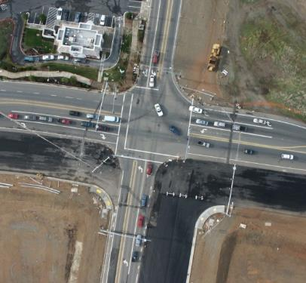
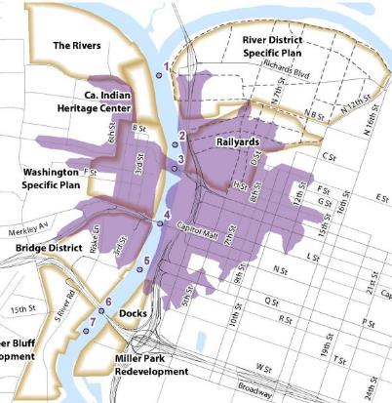
SB 743
Mobility
What SB 743 Does
- Eliminates LOS/Delay as metric to identify a significant environmental impact
- Adds Vehicle Miles of Travel as the metric to evaluate a projects transportation impact
www.fehrandpeers
Accessibility
innovation
Notes:
Delay/LOS no longer the sole basis for impact significance.
VMT new metric that comes with OPR guidance on methodology and significance thresholds.
Elimination of LOS raises potential concerns that traffic safety issues previously addressed through traffic operations analysis will no longer be evaluated. Hence, some agencies including Caltrans are assessing whether safety impact analysis changes are needed. OPR desires no change to occur since SB 743 did not require a change and has provided information in their Technical Advisory about low-VMT generating communities creating fewer safety problems.
Biggest change for cities/counties and developers is that VMT impact analysis in the transportation section requires mitigation in the form of project changes or the addition of a TDM program. Project changes include physical design elements including density, diversity of uses, distance to transit, demographics, development scale to name a few. This creates a potential conflict with developer objectives if the recommended mitigation measures are not sensitive to economic and market factors.
CASE LAW
NEPA
Conservation Law Found. v. FHA (2007) 630 F. Supp. 2d 183
CEQA
Cal. Clean Energy Comm. v. Woodland (2014) 225 Cal.App.4th 173
Cleveland Nat’l Forest Fntd. v. SANDAG (2014) _ Cal.App.4th _

Slide 6
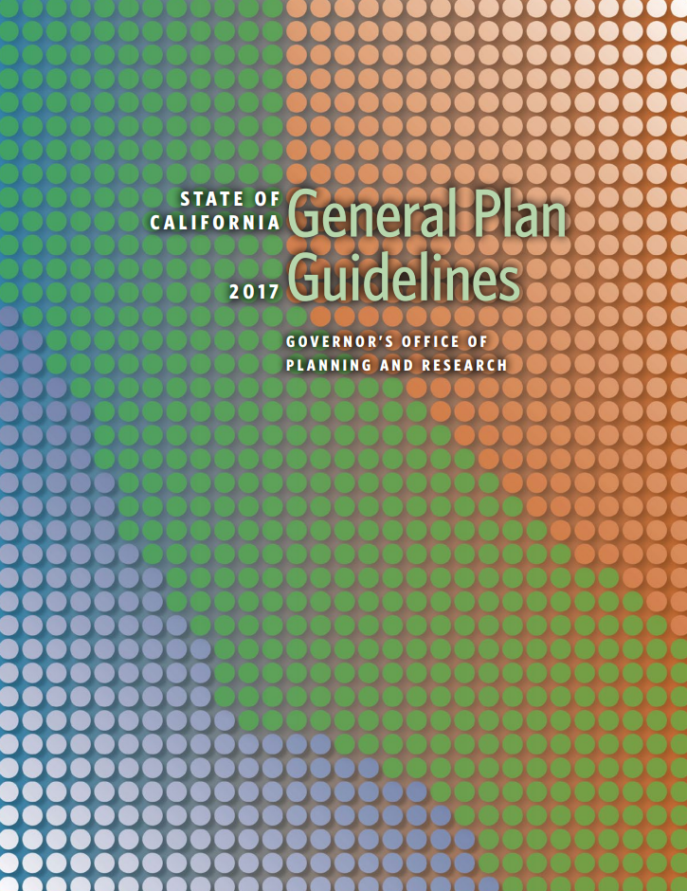
SB 743
What SB 743 Does Not Do…
No change to general plans, traffic impact fee programs, State Constitution, subdivision map act, etc.
Specifically does not include goods movement, agricultural, mining, and other related industries
www.fehrandpeers
innovation
Notes:
Important to recognize that SB 743 did not change general plan law, impact fee law, or any other aspect of the police powers granted to cities and counties under the State and U.S. Constitutions. Hence, LOS may still be used in variety of planning and implementation actions for those communities that value the measurement of vehicle delay or traffic operations.

Slide 7
Guidelines
OPR recommends VMT as the most appropriate measure of transportation impacts
OPR recommends that VMT should be used everywhere in the State
Land use projects within low VMT areas may be presumed to have a less-than-significant transportation impact if specific project criteria is met
Transit, bike, and pedestrian projects should be presumed to have a less-than-significant transportation impact
www.fehrandpeers
innovation

Slide 8
Change
IMPACT ANALYSIS & MITIGATION
Isn’t VMT already included in CEQA documents?
Yes, but not specifically reported in the transportation section and may not reflect full land use and transportation context of a project
It is used to quantify other metrics used for energy, greenhouse gas, and air pollution analyses; however, using it for transportation analysis may involve different types of calculation. For Energy and GHG analyses, all VMT is typically considered but for SB 743 only some trips are considered
www.fehrandpeers
innovation
Notes:
Several different data sources for large-scale analysis have been mentioned. They each have pros and cons, but the MTC model outputs balances them well.
MTC’s Travel Model One is a locally calibrated model with sufficient roadway network and land use detail within Marin County for VMT quantification. The model provides the capability to quantify per-resident and per-worker VMT in accordance with the most recent OPR guidelines.
But, is it up to the lead agency to decide on what methodology they want to use (need to have substantial evidence)
They need to decide how to forecast VMT and must base their thresholds on this

Slide 9
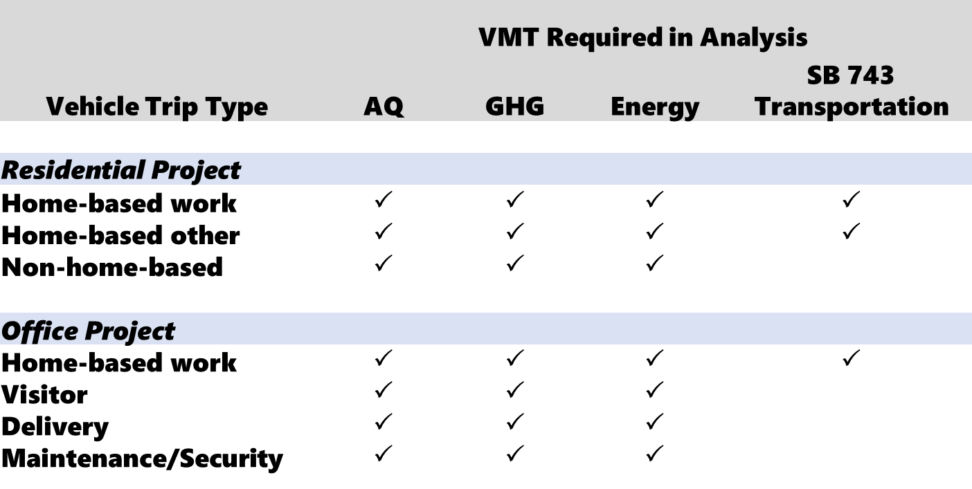
Change
IMPACT ANALYSIS & MITIGATION
Isn’t VMT already included in CEQA documents?
www.fehrandpeers
innovation

Slide 10
Change
IMPACT ANALYSIS & MITIGATION
SB 743 raises new methodology questions**
Look at different types of VMT for different land uses
For Residential: VMT for all home-based trips
For Office: VMT generated by workers
For Retail: may be exempt if less than 50 KSF and local serving; if larger or not local serving, look at net change
Lead agency discretion to set thresholds and analysis requirements for other project types
** Not required to include heavy truck travel, but vehicle types considered should be consistent across analysis.
www.fehrandpeers
innovation

Slide 11
Change
IMPACT ANALYSIS & MITIGATION
www.fehrandpeers
innovation
Notes:
Several different data sources for large-scale analysis have been mentioned. They each have pros and cons, but the MTC model outputs balances them well.
MTC’s Travel Model One is a locally calibrated model with sufficient roadway network and land use detail within Marin County for VMT quantification. The model provides the capability to quantify per-resident and per-worker VMT in accordance with the most recent OPR guidelines.
But, is it up to the lead agency to decide on what methodology they want to use (need to have substantial evidence)
They need to decide how to forecast VMT and must base their thresholds on this

Slide 12
Thresholds
OPR Guidance
OPR suggests a threshold of 15 percent below baseline conditions (meaning when NOP is released)
15%
www.fehrandpeers
Thresholds in the Technical Advisory are non-binding and jurisdictions can develop their own.
innovation
Notes:
OPR Guidance
Land use threshold recommendation 15% below existing regional or city VMT/capita for residential, 15% below existing regional VMT/capita for office
Transportation threshold recommendation is being revised due to issues/errors with the current approach
Use of ‘existing’ equates to baseline so it is always moving forward in time.
OPR Evidence
California Air Resources Board established long-term reduction targets for the largest regions in the state that ranged from 13 to 16 percent.
Caltrans has developed a statewide VMT reduction target in its Strategic Management Plan. Specifically, it calls for a 15 percent reduction in VMT, compared to 2010 levels, by 2020.
Fifteen percent reductions in VMT are typically achievable at the project level in a variety of place types. (Quantifying Greenhouse Gas Measures, p. 55 CAPCOA, 2010).

Slide 13
Thresholds
Considerations
Lead Agency Discretion
Consistency with General Plans
Role of ARB and Caltrans
Legislative intent of SB 743
Consistency with how VMT is measured for Air Quality, Energy and GHG analysis
Does the agency value certain types of VMT over others?
What will the courts decide…
www.fehrandpeers
innovation
Notes:
OPR Guidance
Land use threshold recommendation 15% below existing regional or city VMT/capita for residential, 15% below existing regional VMT/capita for office
Transportation threshold recommendation is being revised due to issues/errors with the current approach
Use of ‘existing’ equates to baseline so it is always moving forward in time.
OPR Evidence
California Air Resources Board established long-term reduction targets for the largest regions in the state that ranged from 13 to 16 percent.
Caltrans has developed a statewide VMT reduction target in its Strategic Management Plan. Specifically, it calls for a 15 percent reduction in VMT, compared to 2010 levels, by 2020.
Fifteen percent reductions in VMT are typically achievable at the project level in a variety of place types. (Quantifying Greenhouse Gas Measures, p. 55 CAPCOA, 2010).

Slide 14
Thresholds
OPR Guidance
OPR Specifies different thresholds for different land uses:
Residential*: 15% below existing city and/or regional** average home-based VMT per capita
Office: 15% below existing regional** average commute VMT per employee
Retail: No net increase in total VMT
* If existing city VMT per capita is used as baseline, development cannot exceed the cumulative number of units in the SCS. ** OPR defines region as the MPO boundary; for Sebastopol, this is the 9-County MTC Region
www.fehrandpeers
innovation
Notes:
OPR Guidance
Land use threshold recommendation 15% below existing regional or city VMT/capita for residential, 15% below existing regional VMT/capita for office
Transportation threshold recommendation is being revised due to issues/errors with the current approach
Use of ‘existing’ equates to baseline so it is always moving forward in time.
OPR Evidence
California Air Resources Board established long-term reduction targets for the largest regions in the state that ranged from 13 to 16 percent.
Caltrans has developed a statewide VMT reduction target in its Strategic Management Plan. Specifically, it calls for a 15 percent reduction in VMT, compared to 2010 levels, by 2020.
Fifteen percent reductions in VMT are typically achievable at the project level in a variety of place types. (Quantifying Greenhouse Gas Measures, p. 55 CAPCOA, 2010).

Slide 15
Thresholds
OPR Guidance
Jurisdiction | Home-Based VMT Per Resident
Sonoma | 28.9
Unincorporated Sonoma County | 21.5
Cotati | 18.3
Petaluma | 17.8
Sebastopol | 17.1
Sonoma County Avg. | 16.6
Cloverdale | 15.8
Bay Area Region* | 15.5*
Rohnert Park | 14.8
Windsor | 14.2
Santa Rosa | 13.5
Healdsburg | 13.3
Jurisdiction | Home-Based Work VMT Per Employee
Bay Area Region* | 22.3*
Petaluma | 18.3
Sonoma | 16.2
Rohnert Park | 14.4
Cotati | 13.0
Sonoma County Avg. | 12.4
Sebastopol | 11.9
Unincorporated Sonoma County | 11.4
Windsor | 11.4
Healdsburg | 11.2
Santa Rosa | 9.4
Cloverdale | 9.3
www.fehrandpeers
innovation
Sonoma County and jurisdiction estimates extracted from the Sonoma County Travel Model 2019 validation for 2019 (published 2/10/22).
*Bay Area Regional (MPO region) Average extracted from TAMDM
Notes:
OPR Guidance
Land use threshold recommendation 15% below existing regional or city VMT/capita for residential, 15% below existing regional VMT/capita for office
Transportation threshold recommendation is being revised due to issues/errors with the current approach
Use of ‘existing’ equates to baseline so it is always moving forward in time.
OPR Evidence
California Air Resources Board established long-term reduction targets for the largest regions in the state that ranged from 13 to 16 percent.
Caltrans has developed a statewide VMT reduction target in its Strategic Management Plan. Specifically, it calls for a 15 percent reduction in VMT, compared to 2010 levels, by 2020.
Fifteen percent reductions in VMT are typically achievable at the project level in a variety of place types. (Quantifying Greenhouse Gas Measures, p. 55 CAPCOA, 2010).

Slide 16
Thresholds
OPR Guidance
For transportation projects:
Bicycle, pedestrian, and transit projects are presumed to not increase VMT
Projects that expand roadway capacity are considered to have potential to cause induced demand; short-term and long-term VMT effects should be evaluated
Thresholds of significance not specified
www.fehrandpeers
innovation

Slide 17
Thresholds
OPR Guidance
Agencies setting thresholds that differ from OPR Guidance should consider the overall intent of SB 743:
Promote the reduction of greenhouse gas emissions
Promote the development of multi-modal transportation network
Promote a diversity of land uses
www.fehrandpeers
innovation

Slide 18
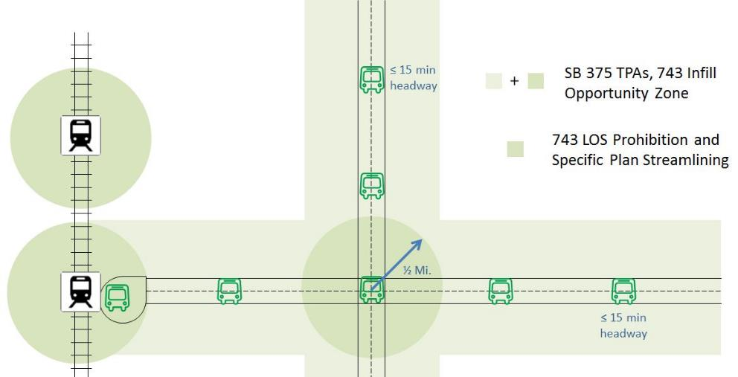
Screening
Transit priority areas
Residential, retail, office, and mixed-use projects located in transit priority areas (TPAs)
www.fehrandpeers
innovation

Slide 19
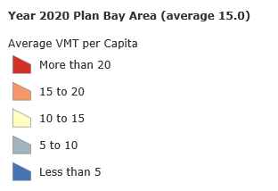
Screening
location
Project located in low VMT generating area
www.fehrandpeers
innovation
Notes:
http://analytics.mtc.ca.gov/foswiki/Main/PlanBayAreaVmtPerCapita;
also, projects that generate less than 110 DAILY trips may be exempt

Slide 20
Screening
location
www.fehrandpeers
innovation

Slide 21
Methods
VMT FORECASTING
VMT = Volume x Distance or
Trips x Trip Length
CEQA Guidelines and Technical Advisory recognize a range of VMT methods:
Qualitative
Spreadsheet
Sketch Planning
Trip-Based Models
Tour-Based Models
Activity-Based Models
www.fehrandpeers
innovation
Notes:
Several different model types allow for different definitions of which trips are associated with a project. For instance, Activity-Based modeling models individual level trips, while trip based modeling takes aggregate trips from a given land use. Simplest of all is to use area averages for a given project type, for both trip generation and trip length.
Activity-based model
Models individual persons and the trips each person makes throughout the day
Trip-based model
Models an aggregation of the types of trips generated by specific land uses (producers and attractors)
Spreadsheet-based method
Relies on traffic counts and average trip lengths for nearby similar uses (most straightforward methodology)

Slide 22
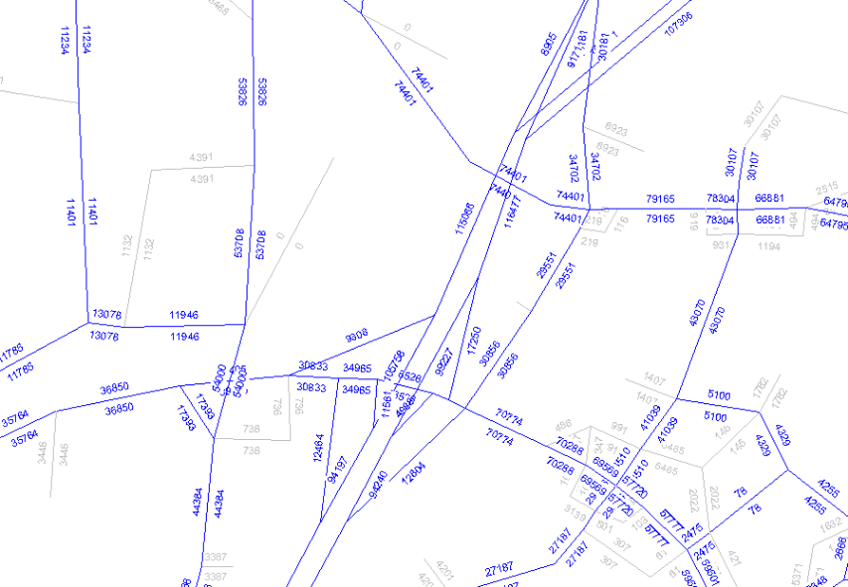
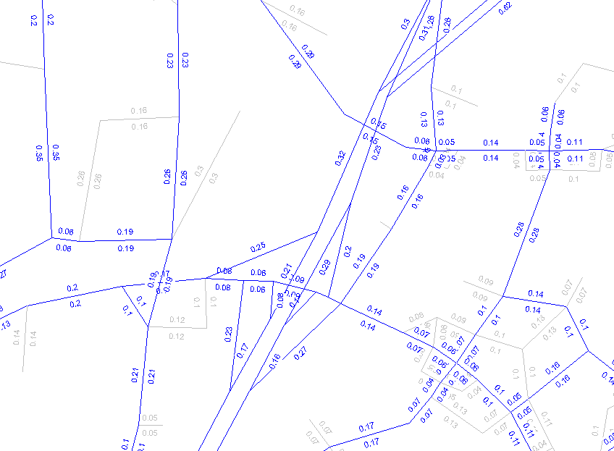
Methods
VMT FORECASTING
VMT = Volume x Distance or
Trips x Trip Length
www.fehrandpeers
innovation
Notes:
VMT is a relatively simple metric to calculate since it involves only two variables. Either trips multiplied by trip length or volume on a roadway link multiplied by the roadway link length. However, there are a wide variety of ways to express the metric in variable form and multiple accounting methods for how to track VMT between land uses.
Two key things to think about are how we determine which trips are relevant to a given project, as well as the length of those trips; which we will get to.

Slide 23
Methods
VMT Forecasting
Origin-Destination (OD) VMT Method
Calculates VMT from individual trips to/from an area
Citrus Heights = 1,397,340 daily VMT (weekday)
www.fehrandpeers
innovation
Notes:
Origin-Destination methods (or full accounting method) estimates or forecasts VMT based on all trips that have at least one end in a project analysis location. In this example the project analysis location is Citrus Heights, CA so the OD method estimates VMT based on all trips that have at least one trip end in the City and accounts for the full length of those trips within the greater SACOG region. This method should be used for GHG and energy impact analysis and is now being specified by OPR as the preferred method for SB 743. Notice that this method generates 1.4 million VMT compared to the boundary method estimate of about 1.0 million. Hence, environmental documents may be required to have multiple VMT estimates, which could cause confusion unless fully explained.

Slide 24
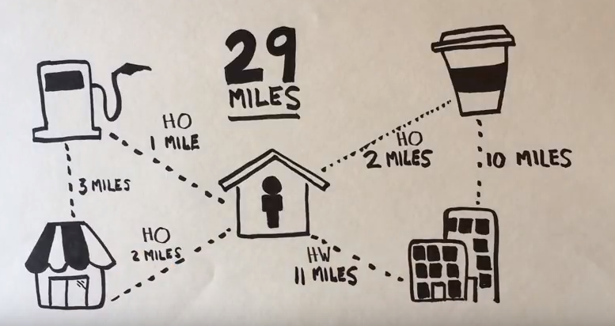
Methods
VMT Forecasting
Choices
Home-Based vs. Household Generated
VMT per resident
www.fehrandpeers
innovation

Slide 25
Methods
Other Considerations
Mixed Use Projects
Unique Projects
Redevelopment Projects
www.fehrandpeers
innovation

Slide 26
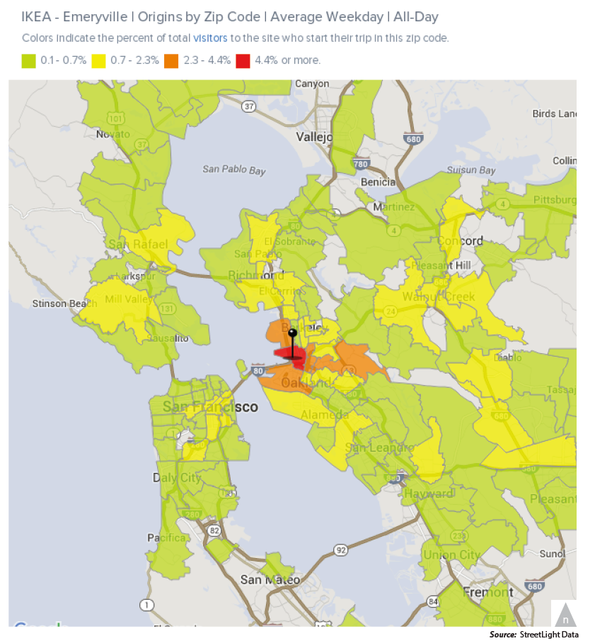
Methods
Local Data is Welcome
Unique land uses could benefit from Big Data on trip lengths
www.fehrandpeers
innovation

Slide 27
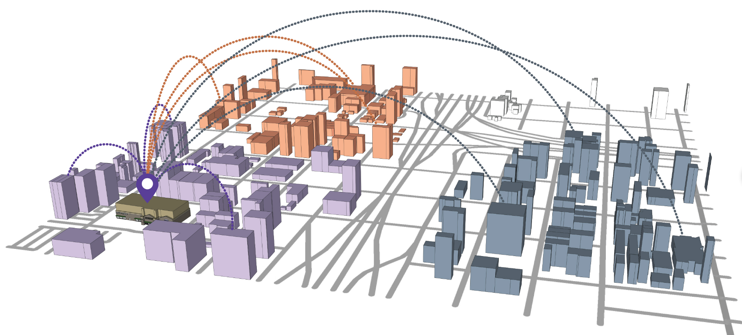
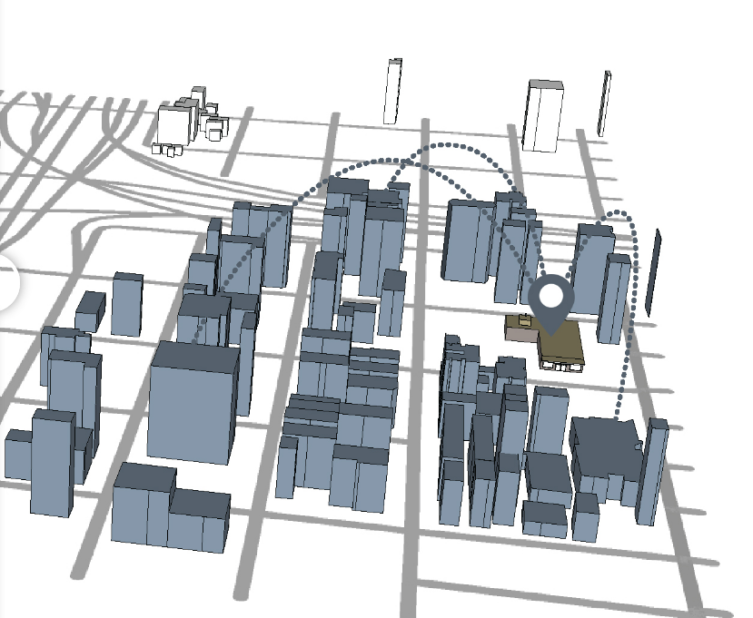
Methods
What VMT CountS?
Project Generated VMT vs. the Project’s Effect on VMT
Notes:
Variants of the O-D method: Full accounting method vs. shared-accounting method
Full accounting – allocating all VMT generated by a project to the project itself
Shared-accounting – sharing VMT between the originating land use and the destination land use
Shared accounting may also incorporate VMT effects, rather than just the trips associated with a land use.
Also, big data should be considered when accuracy is a premium. This data relies on mobile devices to track people and can be used to estimate trip generation activity and trip lengths with high levels of statistical accuracy.

Slide 28
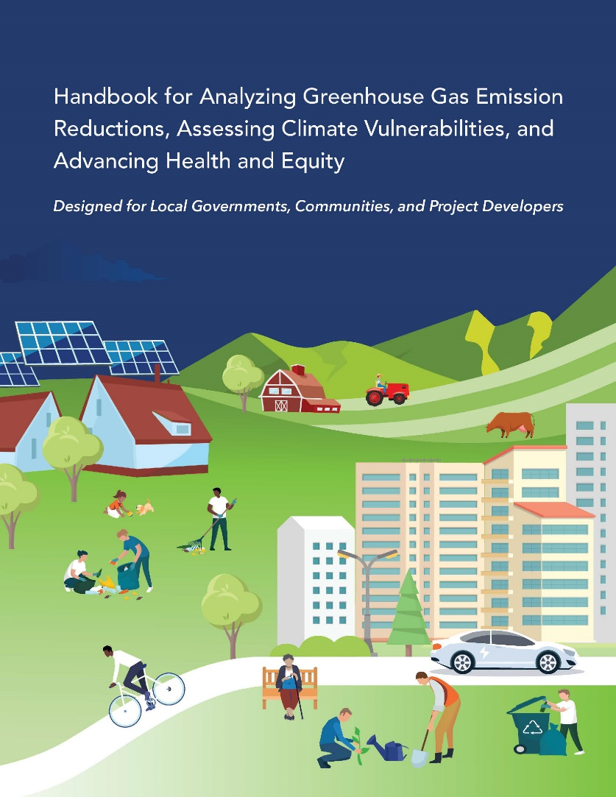
Mitigation
Reduce Trips or trip length
Improve transit access
Increase access to common goods & services
Provide affordable housing
Improve pedestrian or bicycle network
Orient project towards transit, pedestrian or bicycle networks
Provide traffic calming
Provide bicycle parking
Provide transit passes
Provide car sharing
Worksite amenities (showers, bicycle lockers)
Develop Transportation Demand Management Plan
www.fehrandpeers
innovation

Slide 29
Mitigation
Reduce Trips or trip length
Improve transit access
Increase access to common goods & services
Provide affordable housing
Improve pedestrian or bicycle network
Modify project design to orient towards transit, pedestrian or bicycle networks
Provide traffic calming
Provide bicycle parking
Provide transit passes
Project Alternatives
Locate project in area with low existing VMT
Locate project near transit
Increase project density
Increase mix of uses within project or project surroundings
Increase connectivity and/or intersection density on site
www.fehrandpeers
innovation

Slide 30
Mitigation
Reduce Trips or trip length
Improve transit access
Increase access to common goods & services
Provide affordable housing
Improve pedestrian or bicycle network
Modify project design to orient towards transit, pedestrian or bicycle networks
Provide traffic calming
Provide bicycle parking
Provide transit passes
General Plan level
Allocate land use growth in areas with low existing VMT
Locate land use growth near transit
Increase allowable project densities
Allow a greater mix of uses within project or project surroundings
Increase connectivity and/or intersection density in certain areas
VMT mitigation banks & fees
www.fehrandpeers
innovation

Slide 31
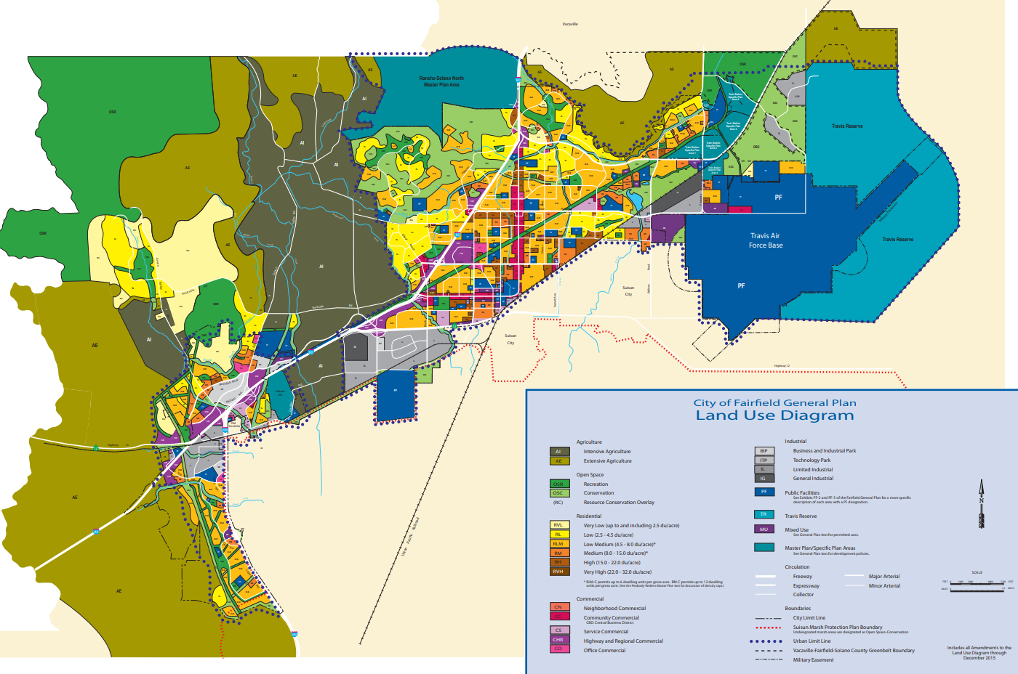
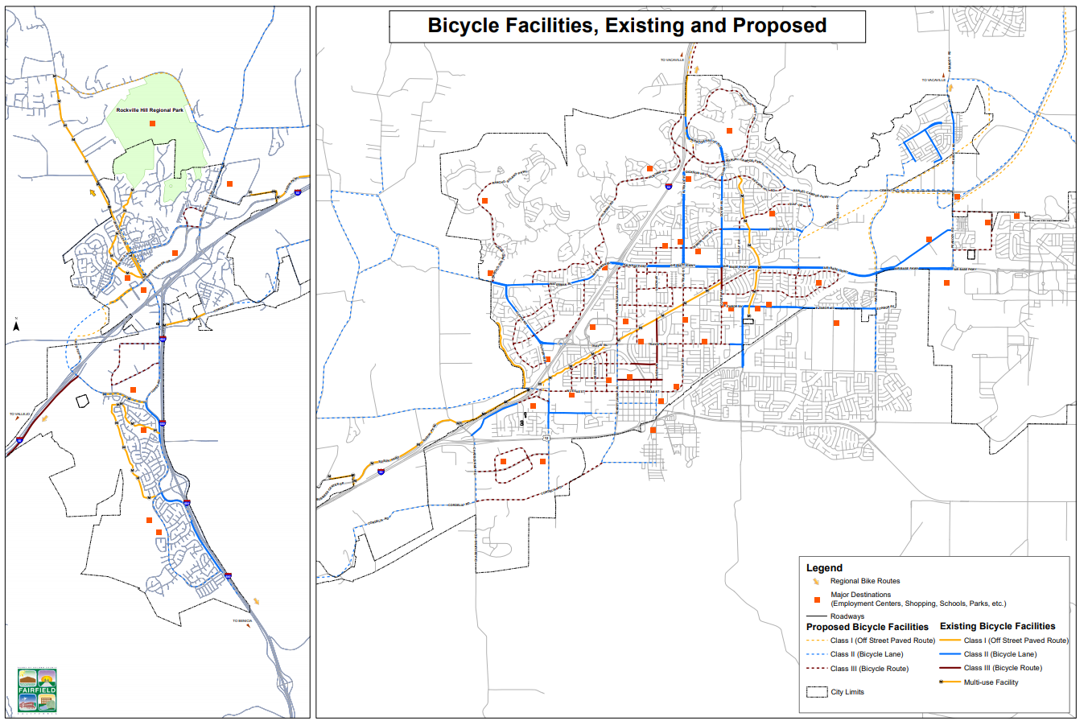
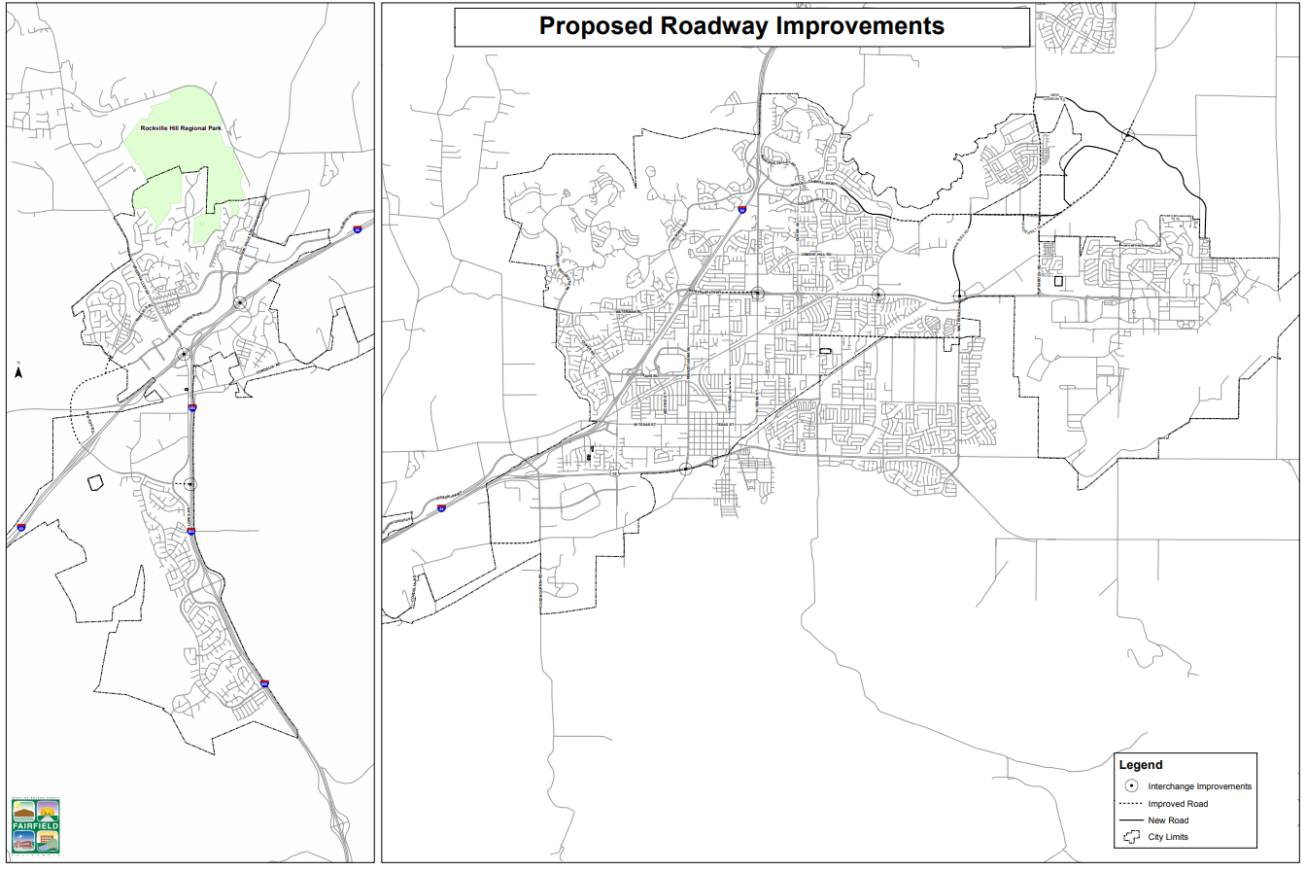
General Plan
Improve transit access
Increase access to common goods & services
Provide affordable housing
Improve pedestrian or bicycle network
Modify project design to orient towards transit, pedestrian or bicycle networks
Provide traffic calming
Provide bicycle parking
Provide transit passes
Considerations:
Timing of General Plan relative to July 1, 2020
Realistic land use program
Circulation system that supports land use (and vice versa)
Achievable VMT thresholds
VMT/TDM mitigation plan for the City
Consistency between LOS policies and VMT policies
www.fehrandpeers
innovation

Slide 32
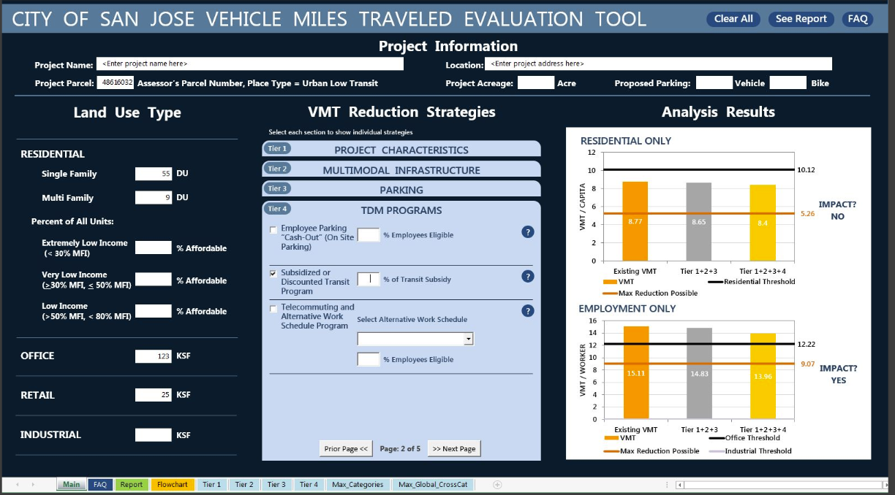
Project Approach
Plan Review and Policy Assessment (February 2019)
Model Review (April 2019)
VMT Assessment (July 2019)
Threshold Setting (August 2019)
VMT Screening & Mitigation Tool Development (December 2019)
Public Outreach and Education (On-going)
Transportation Impact Assessment Guideline Development (January 2020)
Policy Modifications Recommendations (January 2020)
www.fehrandpeers
innovation

Slide 33
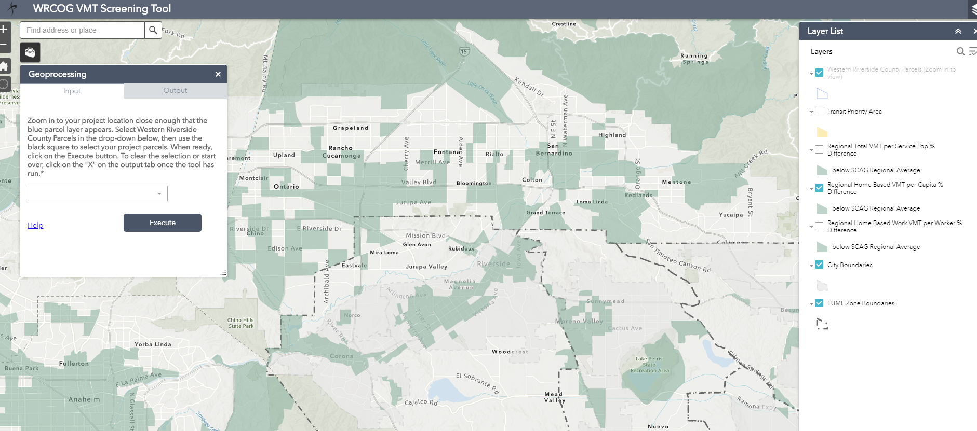
Project Goals
Identify City Polices and Programs that may conflict with the VMT metric
Develop thresholds for City adoption
Develop methodology to evaluate VMT for land development projects
Develop screening criteria and evaluation tool for majority of project types
Develop analysis methods for non-standard projects
Develop Transportation Impact Assessment Guidelines
www.fehrandpeers
innovation

