Slide 1
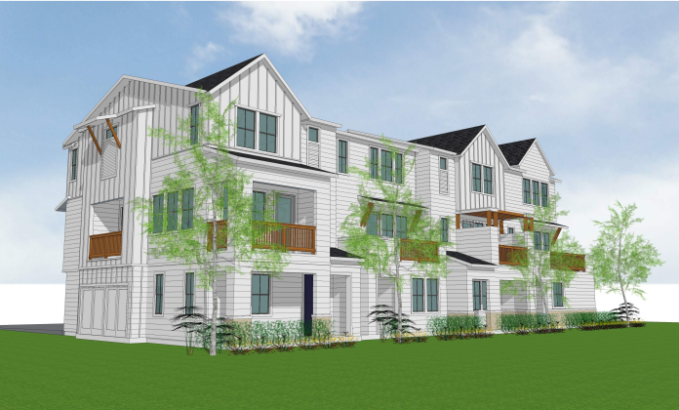

The Canopy Project
ENVIRONMENTAL REVIEW SCOPING MEETING
3:00 PM July 18, 2023

Slide 2
Agenda
Introduction
Project Description
Introduction to CEQA
What is Scoping?
How to Submit Comments
Questions & Comments
Notes:
John

Slide 3
Introduction
City Staff
  John Jay, Associate Planner
  Kari Svanstrom, Planning Director
Rincon Consultants, Environmental Analysis
  Katherine Green, AICP, Project Manager
Notes:
John

Slide 4
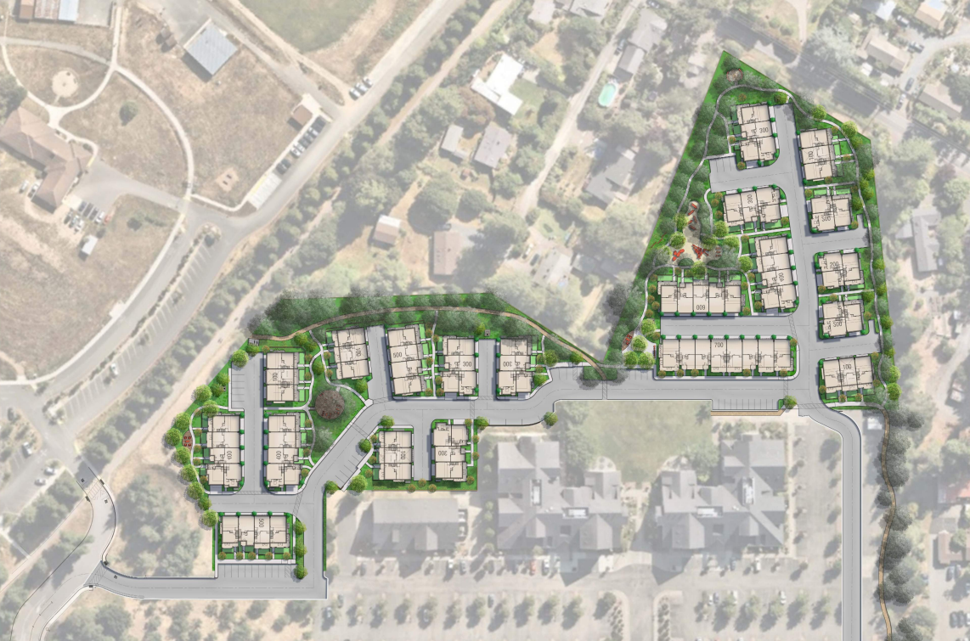
Project Location
Site is located at 1009-1011 Gravenstein Hwy North in Sebastopol, CA (APNs 060-261-028 and 060-261-026)
Encompasses 6.1 acres in Northwest Sebastopol
Land use designation: Low Density Residential
Zoning: Office/ Light Industrial (OLM), 12.1-25 units per acres
Surrounding land: the site is roughly bounded by the O’Reilly Media Center to the west, Gravenstein Highway North to the north, and primarily residential uses to the east and south.
Notes:
John

Slide 5

Project Description
The project applicant proposes the use of a State Density Bonus to allow for a waiver to increase the building height to three stories (6 ft above the max 30 ft height limit).
A new, enhanced 6’ wide pedestrian pathway is proposed to connect the West County Trail out to Gravenstein Highway on the south border of the site.
The project proposes 80 solar all-electric, three-story townhome-style condominiums, with the potential for 16 ADA accessible accessory dwelling units (ADUs).
Requires a conditional use permit for residential only within an Office Light Industrial zone, site development review, and vesting tentative tract map.
Notes:
John

Slide 6

Project Description (continued)
Proposed landscaping would include new plantings throughout the open spaces, along drive aisles, roadways, and streets, and surrounding the proposed buildings.
Other amenities, including gardens, active and passive seating areas, children’s play areas, and a meditation hammock garden are also proposed.
Require the removal of 21 trees while preserving the remaining 111 trees primarily along the perimeter of the site.
Includes a total of 160 parking spaces in garages and 58 surface spaces across the site.
Notes:
John

Slide 7
Introduction to CEQA
California Environmental Quality Act (1970)
Public disclosure and input process
Minimize, reduce, or avoid environmental impacts
Adopt mitigation monitoring program
Project-level analysis
Notes:
Katie
Thanks John. As mentioned earlier, my name is Katie and I’m overseeing the environmental review of this project. So I’m going to go over some background about this environmental review process, explain the purpose behind this particular meeting, and briefly outline the anticipated scope of the document.
The reason we are doing this analysis is because of the California Environmental Quality Act, or CEQA. CEQA was passed in 1970 and is at its core all about public disclosure and input – it requires that we analyze the environmental impacts of a project and take those into consideration before making a decision on a project. We do that through preparing environmental review documents, including Environmental Impact Reports, or EIRs. Which is what we are doing here.
In addition to simply disclosing the anticipated environmental impacts, CEQA also requires that we seek to minimize, reduce or avoid those impacts through what are called mitigation measures.
We also prepare and adopt a mitigation monitoring and reporting program, which typically takes the form of a detailed table of requirements and who is responsible for seeing them out.

Slide 8
CEQA Process
City circulates
Notice of Preparation published
City prepares
Draft EIR
City publishes Draft EIR
Public review period
(45 days)
City prepares
Final EIR
City publishes Final EIR
City makes decision on the project
We are
here
City solicits comment
from agencies and public on the content of the
Draft EIR
City solicits comment
from agencies and public on the adequacy of the
Draft EIR
Responsible agency
decision-making bodies
consider the Final EIR
Notes:
Katie
This slide provides an overview of the CEQA review process for an Environmental Impact Report
The first step is the circulation of a Notice of Preparation during which time the Lead Agency (in this case the City) solicits input on the content of the Draft EIR
The Notice of Preparation for this project was published on July 6, 2023
We are currently on this initial step, and the purpose of this meeting is to collect comments on the EIR content
Next, a Draft EIR will be prepared, and then published
During the 45-day Draft EIR review period, comments on the adequacy of the Draft EIR are solicited
Following completion of the Draft EIR circulation period, a Final EIR is prepared, including responses to comments on the Draft EIR, errata noting any changes to the Draft EIR, and a mitigation monitoring program
The Final EIR is then published, at which time Responsible Agencies will consider the Final EIR
Finally, the Lead Agency makes a decision on the project

Slide 9
Purpose of Scoping Session
Public input on the environmental analyses
Topic areas
Issues of concern
Potential alternatives to the project
Propose mitigation measures
Notes:
Katie
We are here today to receive scoping comments
Scoping invites public input on the environmental analysis that will be conducted
Scoping comments can suggest topic areas to address, identify issues of concern, suggest potential alternatives to the project, and/or propose mitigation measures
We will not be recording scoping comments verbatim today; instead, comments will be summarized
If you would like to provide detailed comments, we encourage you to do so in writing

Slide 10
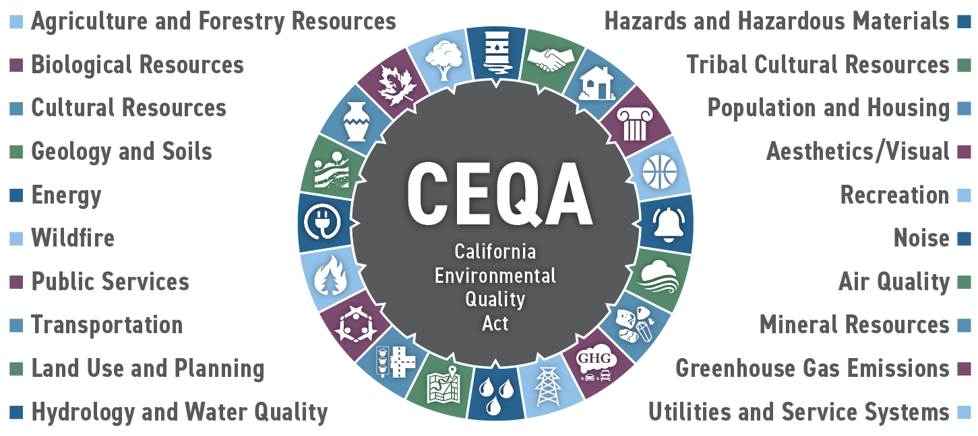
Environmental Analysis
Notes:
Katie
CEQA requires an analysis of 20 separate issue areas, which are listed on this slide
The issue areas we intend to analyze in detail in the EIR include all the resources shown above

Slide 11
EIR Structure
Introduction and Summary
Project Description
Environmental Impact Analysis
Alternatives
Other Impacts
Each topic area includes:
  Environmental Setting
  Potential Impacts
  Mitigation Measures
  (where potentially significant impacts are identified)
Notes:
Katie
Once the Draft EIR is available, it will follow the structure shown here – there will be an introduction and exec summary, which is a great place to look to get a snapshot of the issue areas, impacts, and mitigation measures required.
There will be a detailed description of the project.
The “meat” of the EIR will be the environmental impact analysis. For each of the issue areas I just mentioned, we will have a stand alone chapter that includes a setting section – laying out the physical environmental and regulations relevant to that issue, an analysis of project impacts, and identification of mitigation measures where required. Need to look at this section for detail not found in the ES.
Another key section of the EIR is the alternatives chapter, which will include a required no project alternative and other “build” alternatives intended to reduce or eliminate significant effects of the project, while still achieving most of the basic project objectives.
Other CEQA required sections, such as significant irreversible effects and growth inducement will also be covered.

Slide 12
How to Submit Comments
Deadline: August 7, 2023
Physical address
    Planning Division
    Attn: John Jay, Associate Planner
    City of Sebastopol
    7120 Bodega Avenue
    Sebastopol, California, 95472
  Email address
  jjay@cityofsebastopol.org
  Subject Line: “The Canopy Project NOP”
Notes:
Katie
So again, we are at the beginning of this process and just embarking on this analysis. What we want from the public is input on the scope of the document – again, if there’s a key environmental issue you think should be considered, or an alternative or mitigation measure you’d like to see included. Please provide that information now.
Comments due by Monday, August 7. Two ways to submit written comments: snail mail or email. Information shown here.
Third option is to provide verbal comments now – we will take detailed notes and we are also recording. So this will be captured in the record and taken into consideration the same way as verbal.
If over 10 people, limit speaking length to 3 minutes each.

Slide 13
Thank you!
Please use the “Raise Hand” feature to submit a question or comment.
Notes:
Raise hand – 3-minute limit only if over 10 people in attendance (besides staff)

